Slide 1
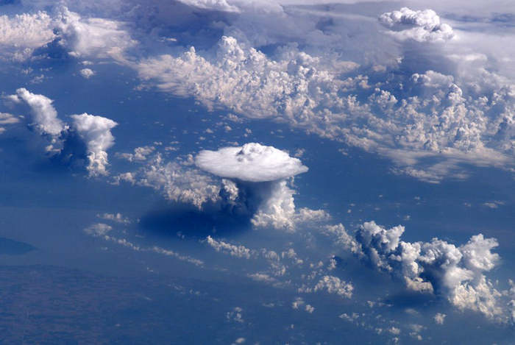
Studies of convectively induced turbulence
Todd Lane
The University of Melbourne, Australia
Contributions from: Dragana Zovko Rajak (Australian Bureau of Meteorology), Bob Sharman (NCAR), Stan Trier (NCAR)
Turbulence Impact Mitigation Workshop V3. McLean VA 5-6 Sep 18

Slide 2
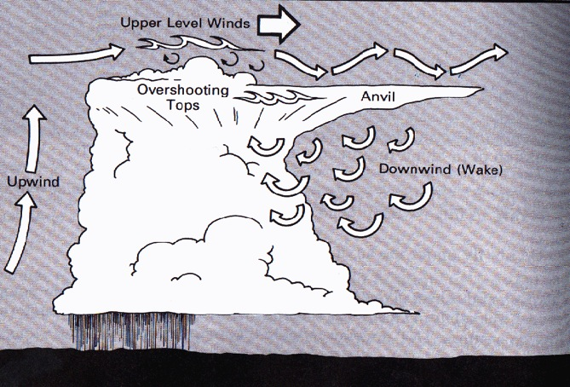
INTRODUCTION / MOTIVATION
From Lester 1994, Turbulence: A new perspective for pilots

Slide 3
INTRODUCTION / MOTIVATION
From Lester 1994, Turbulence: A new perspective for pilots

Slide 4
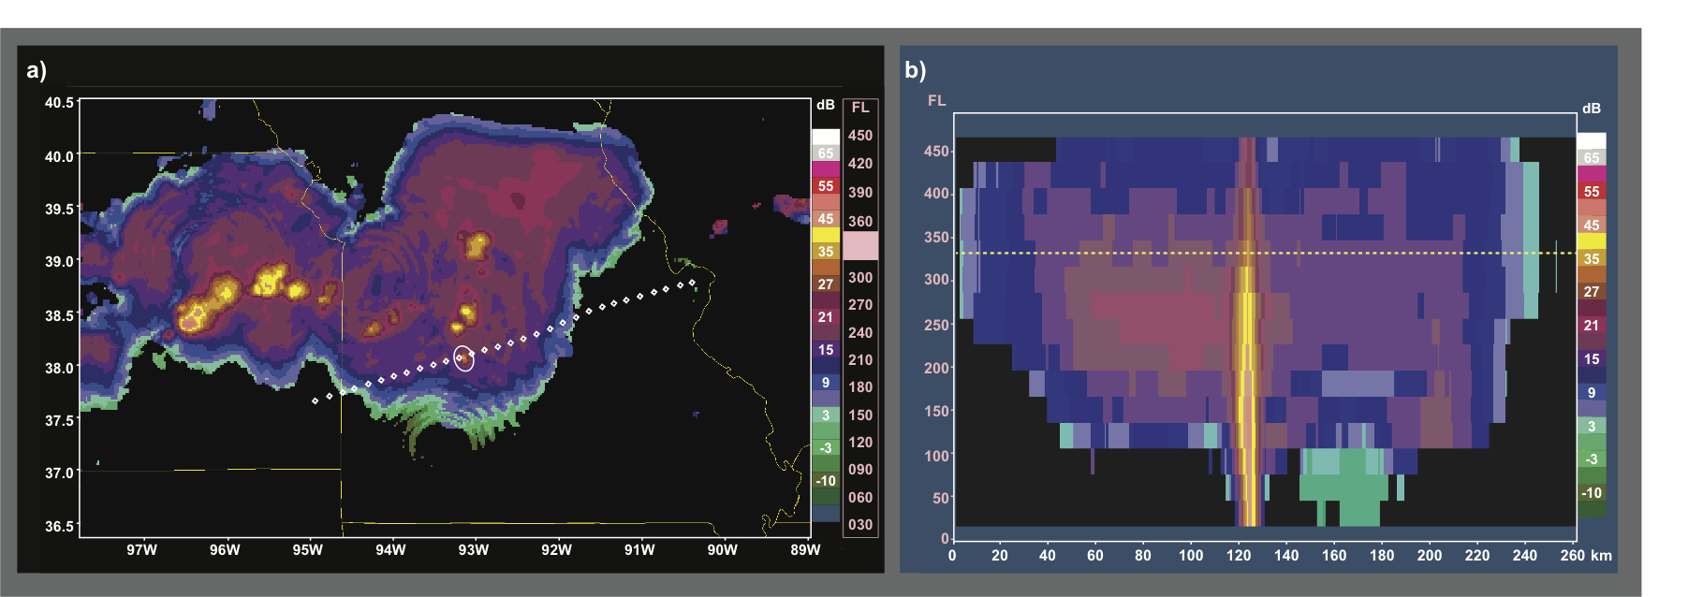
Example cases of convectively induced turbulence (CIT)
21 injuries over Missouri: in-cloud CIT
20 July 2010, Washington DC to LAX

Slide 5
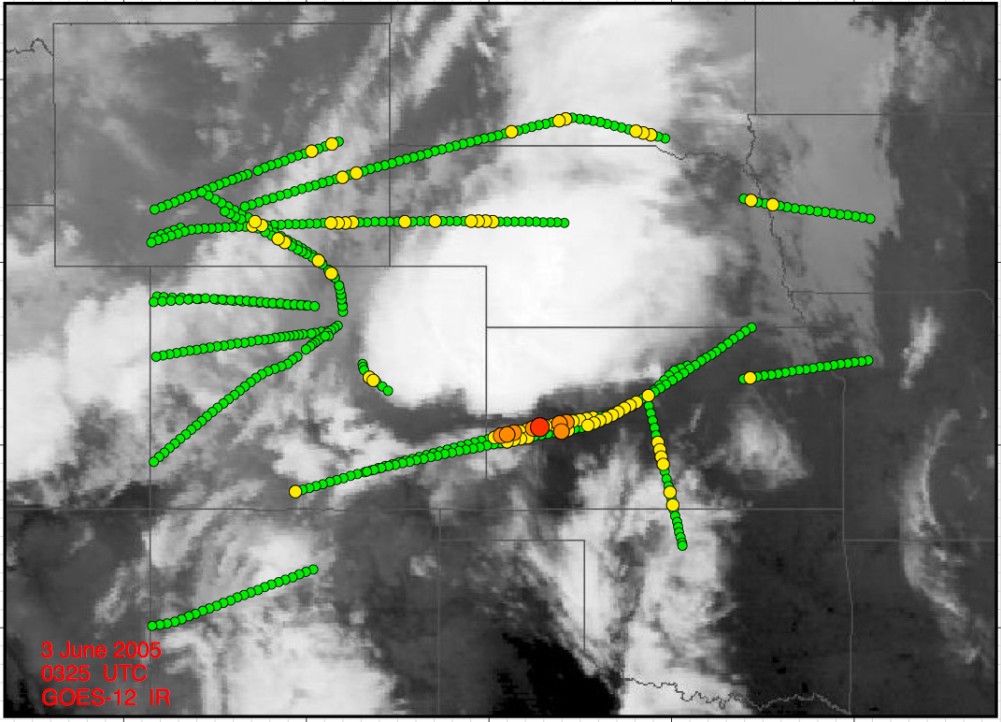
Example cases of convectively induced turbulence (CIT)
Automated EDR measurements
(1 hour, FL200-FL410)
Green – null Yellow – light
Orange – moderate Red - severe
Notes:
Severe Report about 50 km from cloud boundary

Slide 6
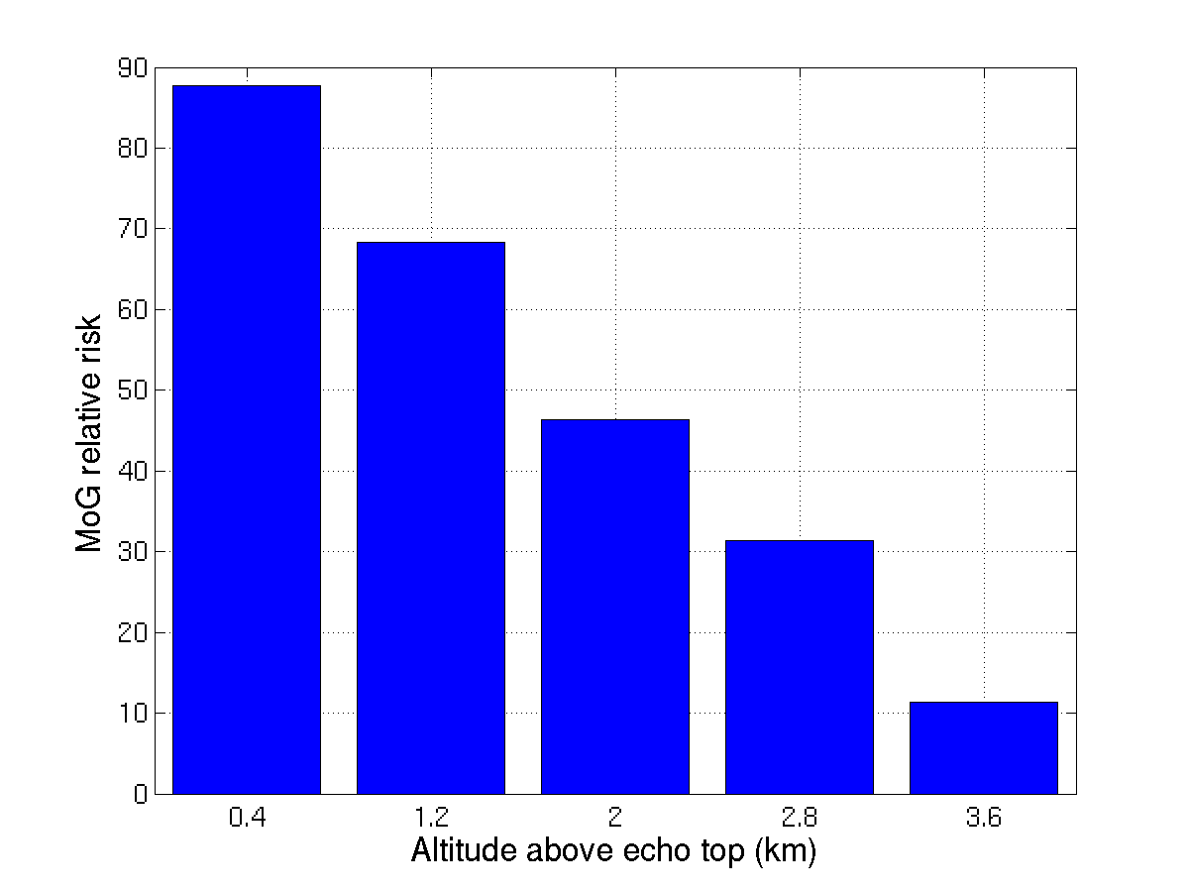
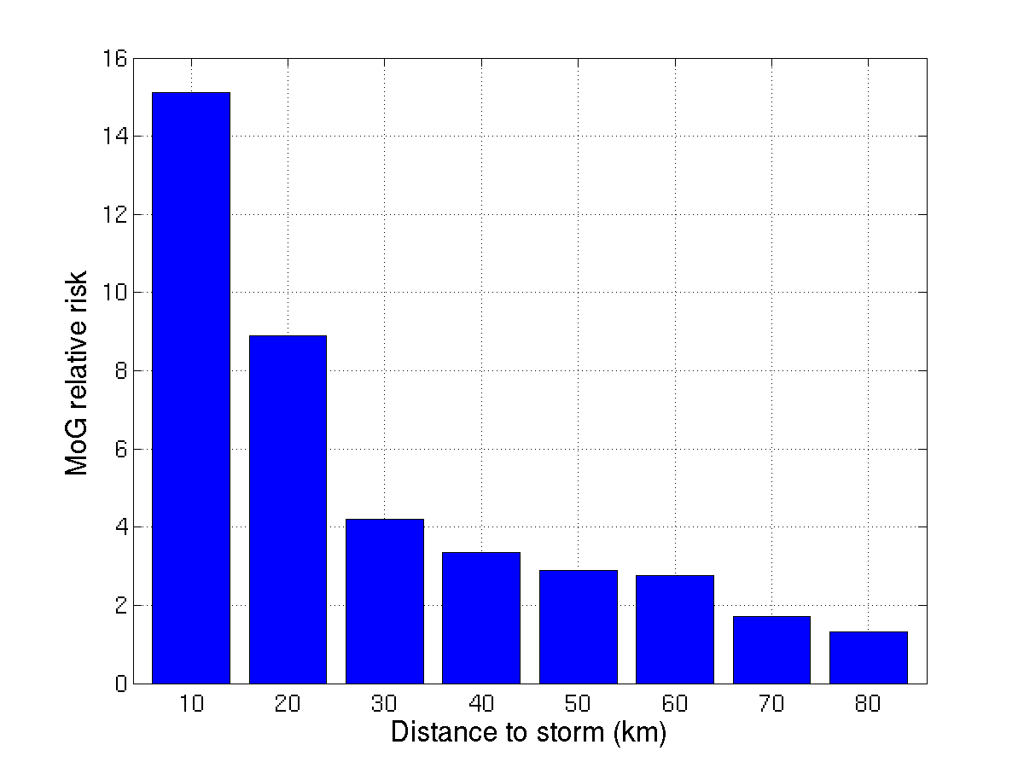
Risk of Moderate-or-Greater (MOG) turbulence relative to storms
MOG = peak EDR > 0.3 m^{2/3}s⁻¹
4x
10x
From Lester 1994, Turbulence: A new perspective for pilots
EDR-derived measurements over the USA compared to NEXRAD derived cloud boundaries
> 7 million peak EDR reports for 2004 - 2005 warm seasons (May-Oct) between 25-42,000 ft.
‘Relative risk’ refers to background occurrence (0.03% of all reports are MOG).
E.g., relative risk of 10 means that MOG is 10x more likely to occur at that location
Significantly enhanced risk (10x) at 12,000 ft (3.6 km) above cloud
MOG 4x more likely at ~20 miles (30 km) from storm – c.f. FAA guidelines
50 % of MOG reports are within 100 km of storms
Analysis by John Williams - from Lane et al. (2012, BAMS)

Slide 7
HIGH-RESOLUTION SIMULATIONS TO UNDERSTAND GENERATION
Observations
Severe report at:
0319 UTC
38,000 ft (=11.9 km above sea level)
~31 miles (50 km) from cloud boundary

Slide 8
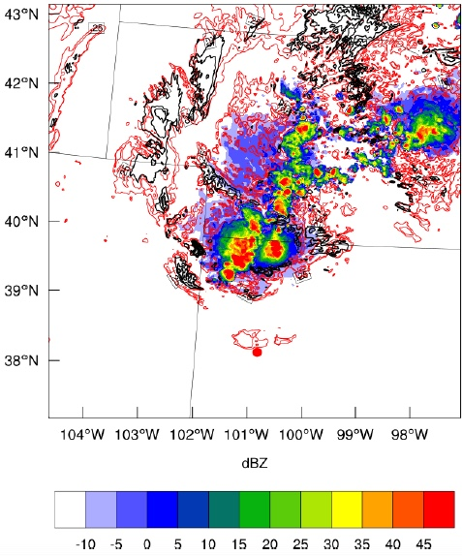
HIGH-RESOLUTION SIMULATIONS TO UNDERSTAND GENERATION
Observations
1.1 km resolution simulation (WRF)
Radar reflectivity (colors)
Turbulence Kinetic Energy (red lines)
Low Richardson number (black lines)
Severe report at:
0319 UTC
38,000 ft (=11.9 km above sea level)
~31 miles (50 km) from cloud boundary
z=12.5 km, 0320 UTC

Slide 9
HIGH-RESOLUTION SIMULATIONS TO UNDERSTAND GENERATION
Observations
1.1 km resolution simulation (WRF)
Radar reflectivity (colors)
Turbulence Kinetic Energy (red lines)
Low Richardson number (black lines)
Severe report at:
0319 UTC
38,000 ft (=11.9 km above sea level)
~31 miles (50 km) from cloud boundary
z=12.5 km, 0320 UTC

Slide 10
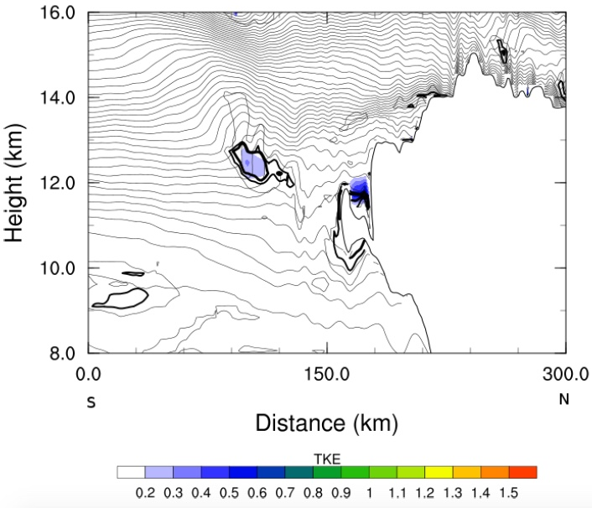
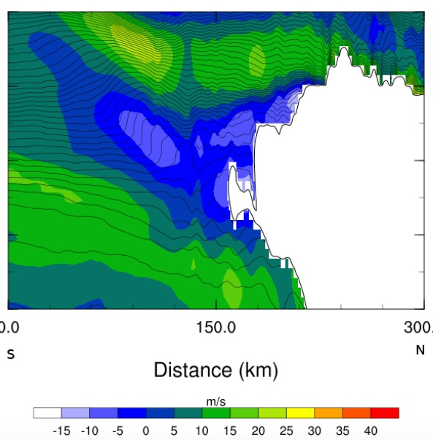
HIGH-RESOLUTION SIMULATIONS TO UNDERSTAND GENERATION
Turbulence Kinetic Energy
S-N Velocity
Localized (and transient) turbulence at about 30-50 miles (50-80 km) from storm
Related to wave processes (local wave breaking)
Simulations represent occurrence reasonably well, but unable to provide good measures of intensity due to resolution

Slide 11
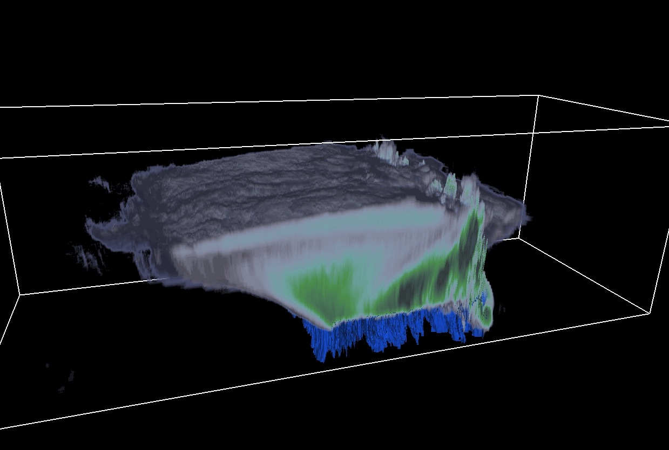
Idealized simulations to characterize intensity
Large-eddy simulations (75 m grid spacing) can resolve turbulence

Slide 12
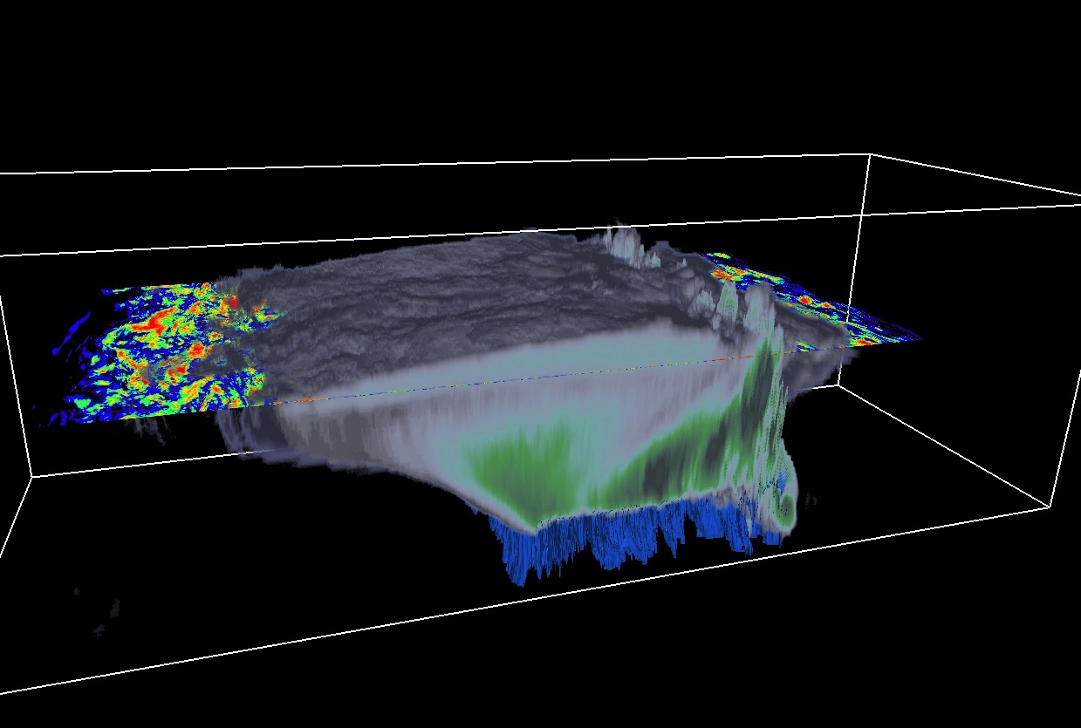
Idealized simulations to characterize intensity
RESULTS: 3D Structure (cloud & 10-km vorticity)

Slide 13
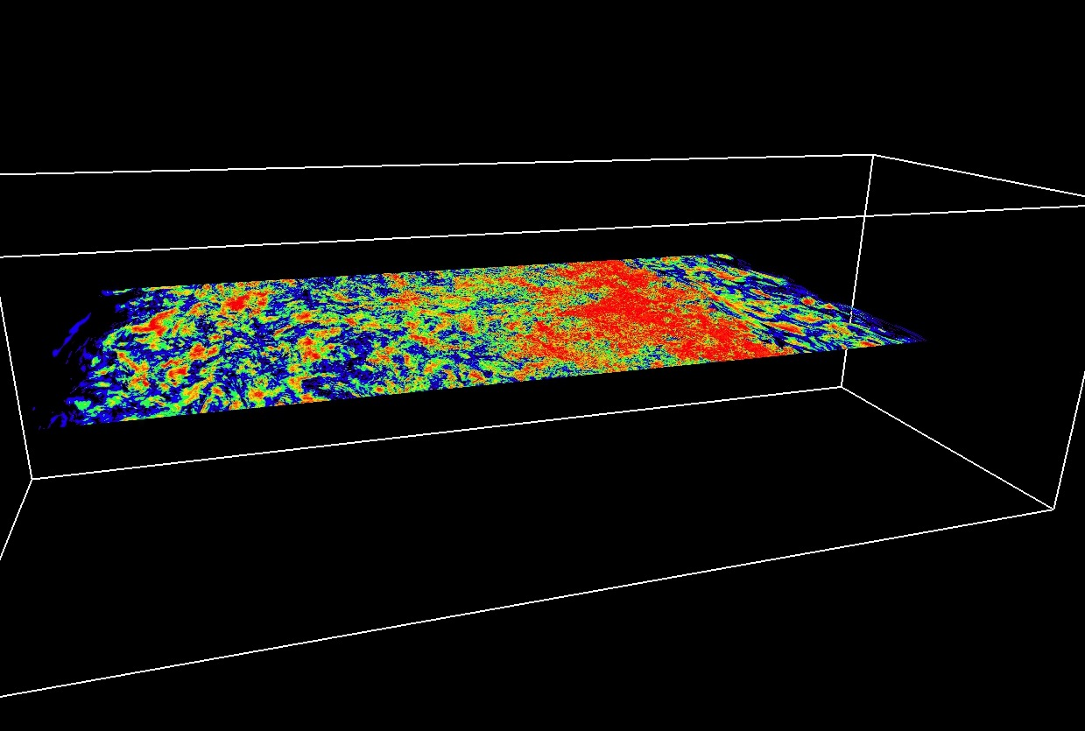
Idealized simulations to characterize intensity
RESULTS: 3D Structure (cloud & 10-km vorticity)

Slide 14
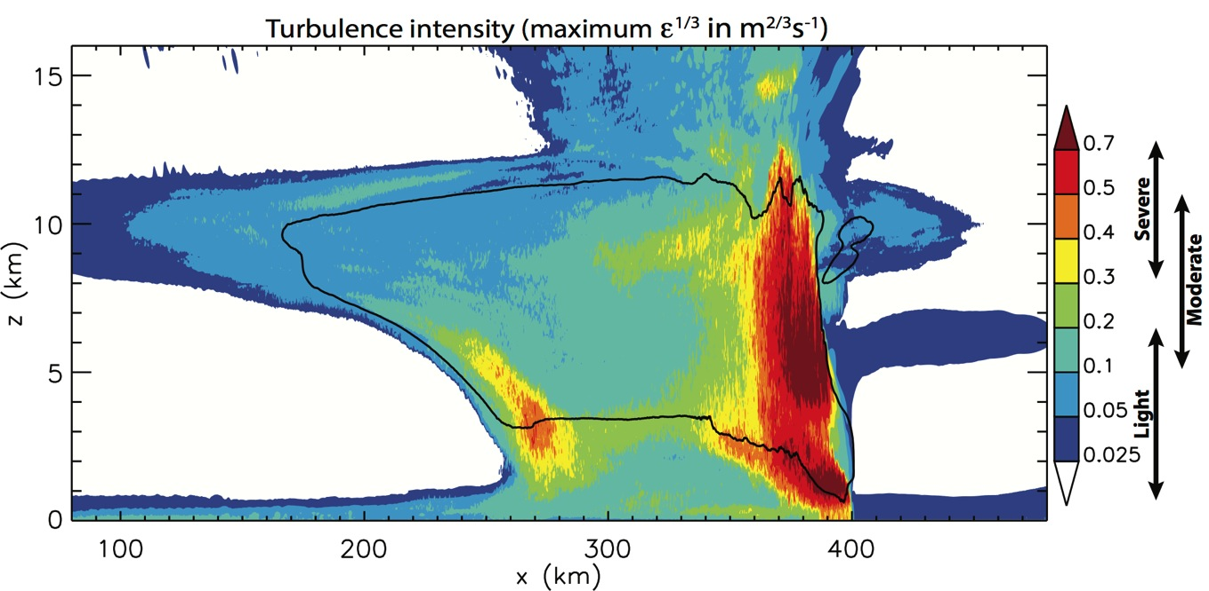
Idealized simulation to characterize intensity (squall line)
Calculated in the same way as commercial aircraft: estimate EDR (Eddy Dissipation Rate, ε^{1/3}) along overlapping short (9 km long) segments in y-direction.
Corresponding subjective intensity determined from comparisons to PIREPS (Sharman et al. 2014)
from Lane and Sharman (2014, GRL)
Notes:
Using the relation for the transverse component: |û|²=⁴/₃Cε^{2/3}k^{-5/3}, C=0.5

Slide 15
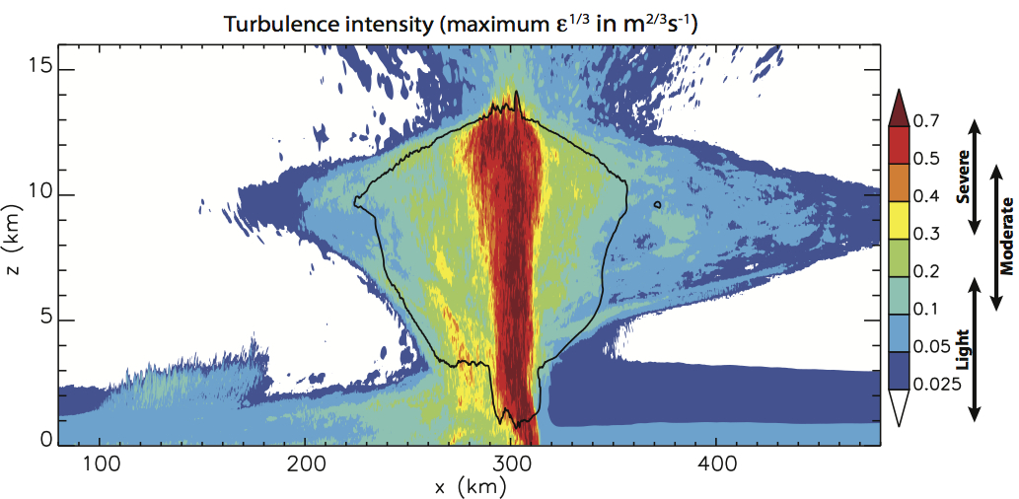
Idealized simulation to characterize intensity (upright storm)
Upright storm has broader turbulence extent ahead of storm
Storm characteristics matter in determining risk of turbulence relative to cloud boundary – related to upper outflow of storm (among other things)
Notes:
Upright storm (created with deeper [5 km deep] shear profile) has broader turbulence extent ahead of storm
Using the relation for the transverse component: |û|²=⁴/₃Cε^{2/3}k^{-5/3}, C=0.5
Calculated in the same way as commercial aircraft: estimate ε^{1/3} along overlapping short (9 km long) segments in y-direction.

Slide 16
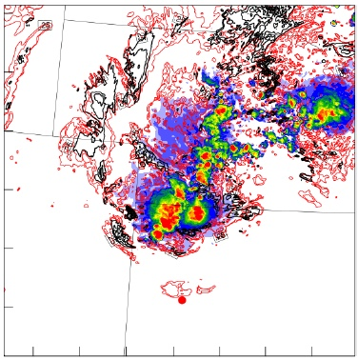
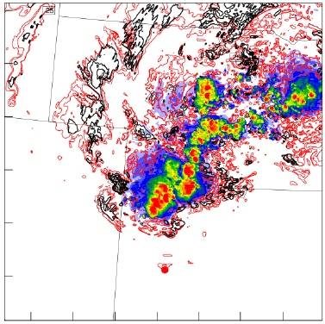
The way forward? Prediction with high-resolution NWP
320 UTC
340 UTC
Moist convection and turbulence both suffer from low predictability
Ensemble approaches essential to capture uncertainty in both convection and turbulence
Complicated implementation into air traffic operations due to highly detailed spatial structures and intermittency

Slide 17
SUMMARY
There is an enhanced risk of turbulence that extends significant distances above and around convective storms
Significant progress has been made in recent years to better understand the mechanisms of turbulence around clouds
Wave processes, enhanced wind shear, sensitivity to storm type, etc.
High-resolution weather prediction is capable of identifying specific regions of enhanced turbulence likelihood
How can these advances be best utilized to improve avoidance methods to reduce turbulence encounters? E.g.,
Improved guidelines for tactical avoidance
Diagnosis (for nowcasting) of risk based on theory, models, and remote sensing
High-resolution Numerical Weather Prediction
Turbulence Impact Mitigation Workshop V3. McLean VA 5-6 Sep 18

