Slide 1
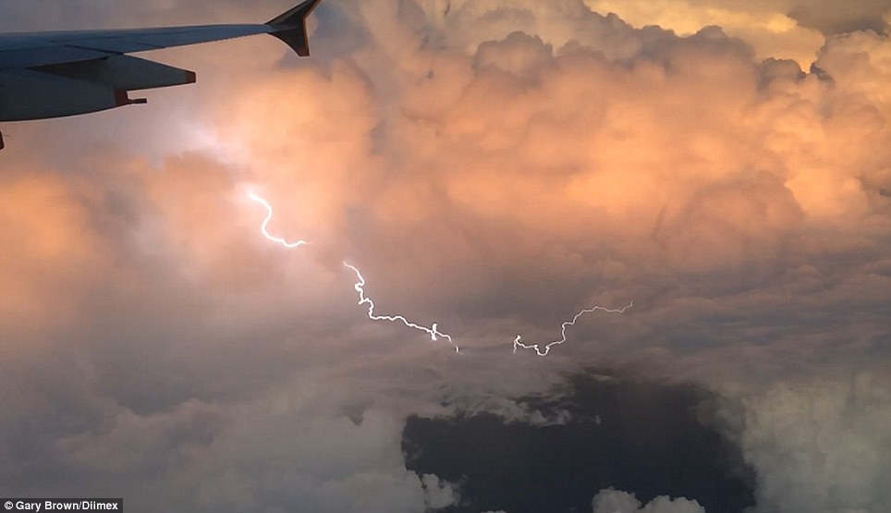
New Developments in the Graphical Turbulence Guidance (GTG) Forecasting System
Wiebke Deierling, Robert Sharman,
Domingo Muñoz-Esparza and Julia Pearson
National Center for Atmospheric Research

Slide 2
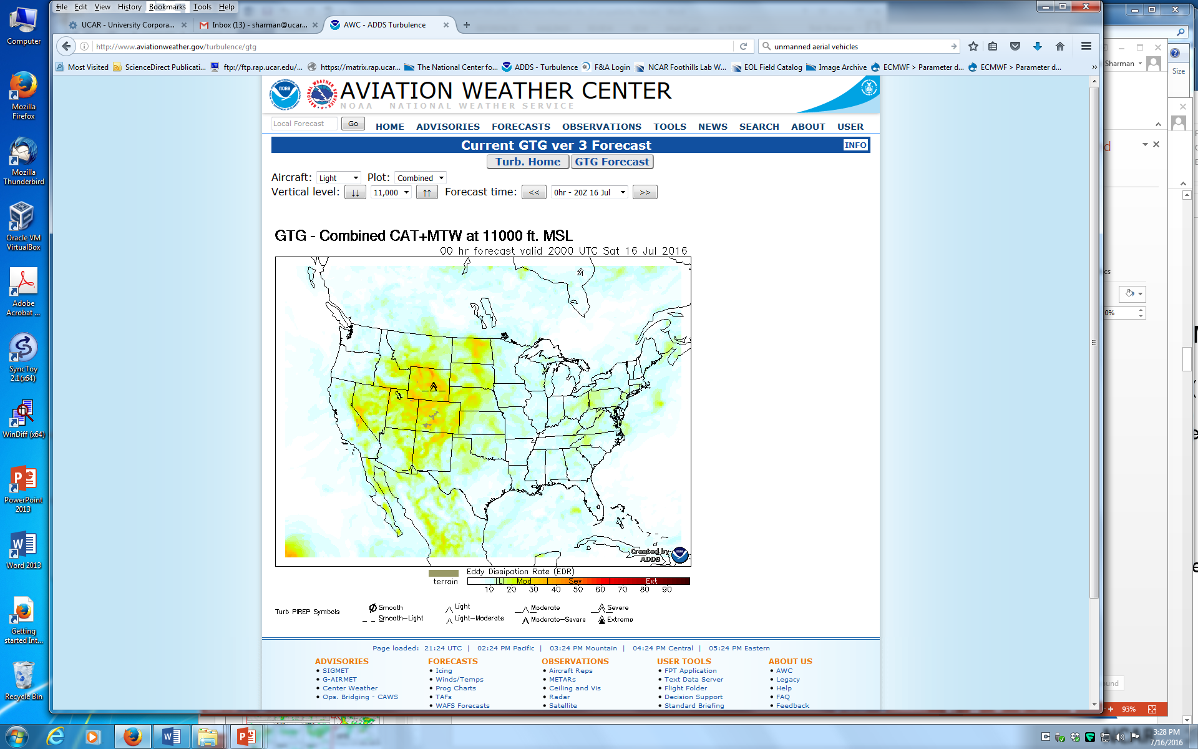
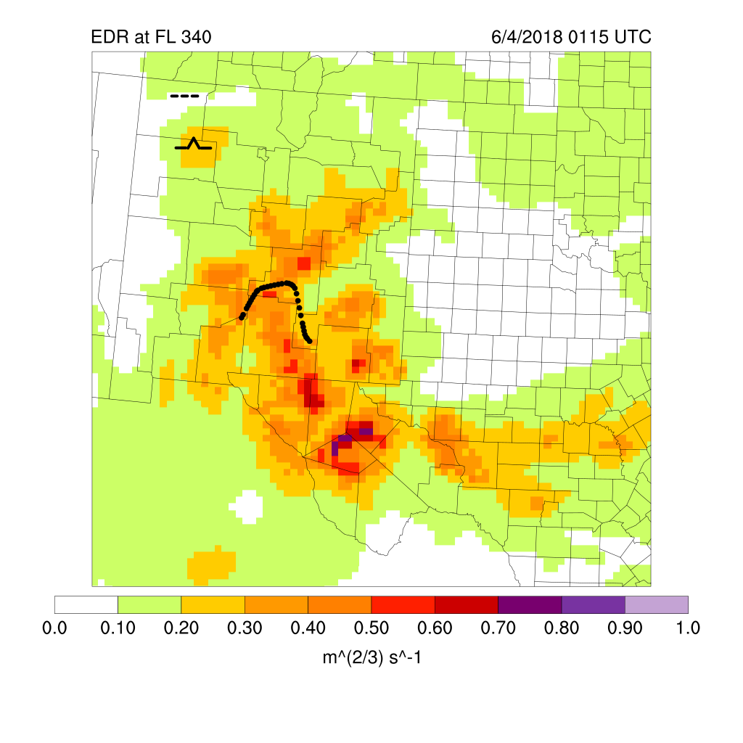
Goals & Products
Work Areas
  Develop forecast products for strategic avoidance (GTG)
  Develop nowcast products for tactical avoidance (GTGN)
  Develop more and improved observations
  Support transition to operations (e.g. NCEP, AWC) of products and global harmonization of global turbulence forecasts
  All products estimate a turbulence intensity metric termed “EDR” (energy or eddy dissipation rate^{1/3})
GTG
GTGN
NTDA

Slide 3
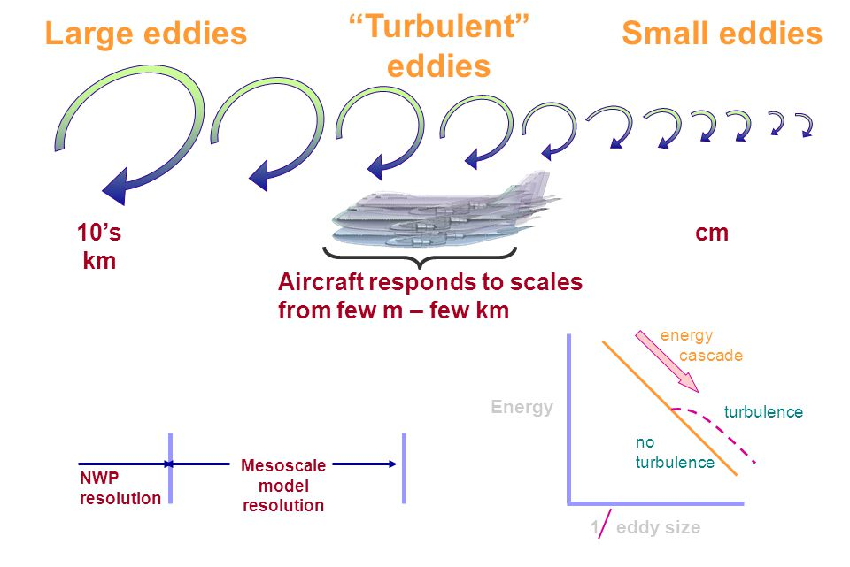
Turbulence Scales and Model Forecasts

Slide 4
Graphical Turbulence Guidance
Forecast system is called the Graphical Turbulence Guidance (GTG)*
  Can be based on various models (RAP, GFS, UK-Met etc.)
  Currently adapting it to HRRR, FV3
Assumes large scale model resolved turbulence sources linked to aircraft scale turbulence
Computes suite of turbulence diagnostics for MWT, CAT and LLT
Currently adding in-cloud CIT diagnosis based on HRRR
GTG = MAX of ensemble weighted mean:
GTG=MAX(CAT, MWT, LLT, CIT)
Outputs Eddy Dissipation Rate (EDR) for low, mid and high levels
CAT = W₁D₁ + W₂D₂ + W₃D₃ + ….
MWT= W₁D₁ + W₂D₂ + W₃D₃ + ….
LLT = W₁D₁ + W₂D₂ + W₃D₃ + ….
CIT = W₁D₁ + W₂D₂ + W₃D₃ + ….
  *Sharman et al. Weather & Forecasting 2006
  Sharman and Pearson, J Appl Met Climate, 2017
  Pearson and Sharman, J Appl Met Climate, 2017

Slide 5
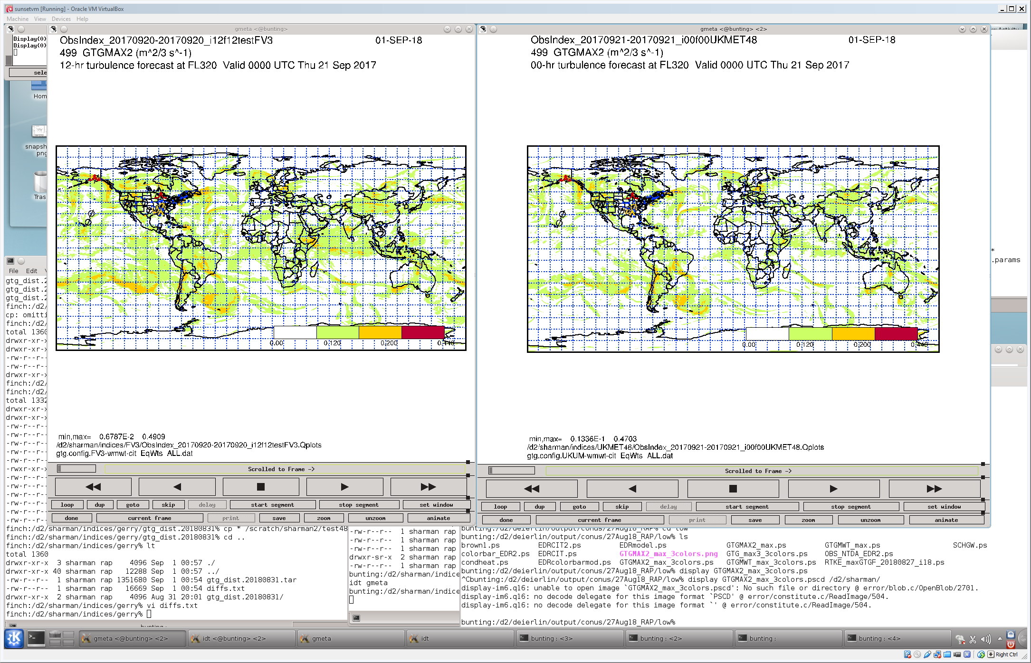
Graphical Turbulence Guidance Enhancements
    Made code base changes of the global GTG (GTG-G) to run on FV3 model in NCEP UPP infrastructure and include UKMO NWP model to support WAFS.
    Collaboration with Jung-Hoon Kim at AWC on probabilistic GTG-G
GTG NCEP FV3 global model
12 hr Forecast
FL320; 0Z 21Sept2017
GTG UKMO global model
0 hr Analysis
FL320; 0Z 21Sept2017

Slide 6
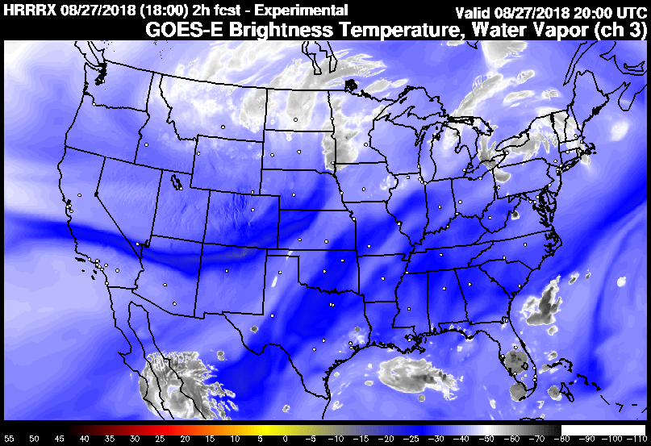
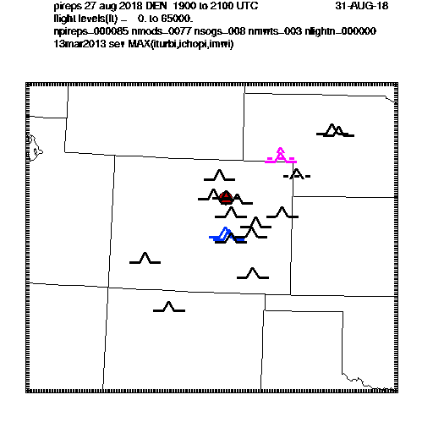
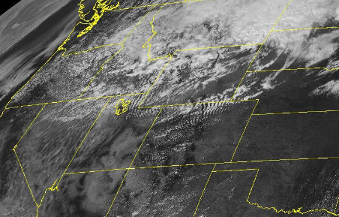
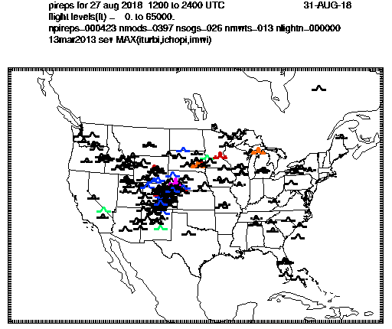
Graphical Turbulence Guidance Enhancements
  Upgrading to new GTG CONUS version that is based on HRRR:
    Improved low level (LLT)
    Adding convectively induced turbulence (CIT) capability
    Adaptation/calibration of CAT & MWT to HRRR
  MWT Example, 27 August 2018 at 20 UTC

Slide 7
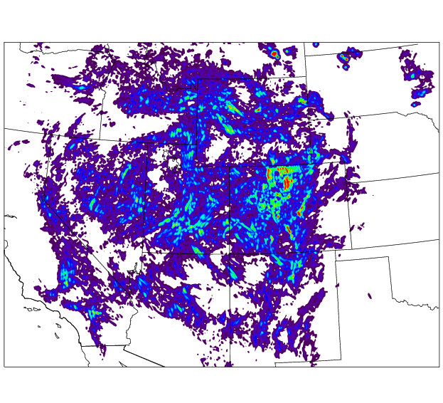
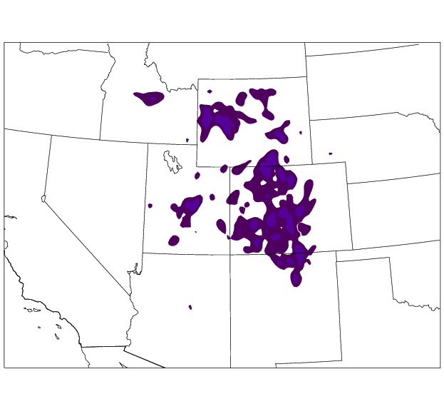
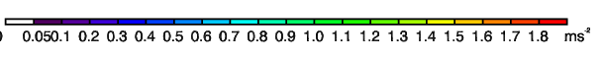
Graphical Turbulence Guidance Enhancements
  HRRR versus RAP MWT index: d_{s} x|DIV|
  2 hr forecast valid 27 August 2018 at 20 UTC , FL 330

Slide 8
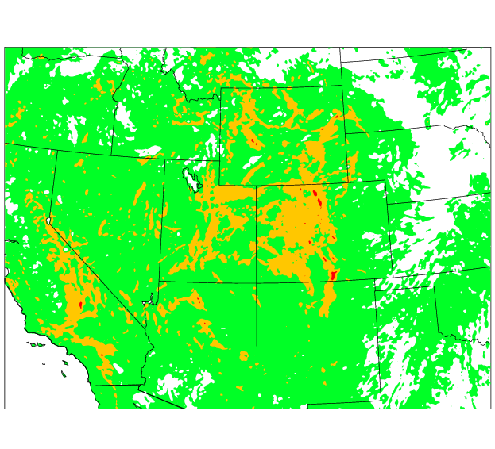
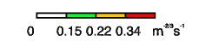
Graphical Turbulence Guidance Enhancements
    Improved low level turbulence (LLT) diagnosis for HRRR compared to RAP (see Domingo Muñoz-Esparza talk)
  GTG HRRR - LLT Example, 2hr forecast
  27 August 2018 at 20 UTC, z~1km

Slide 9
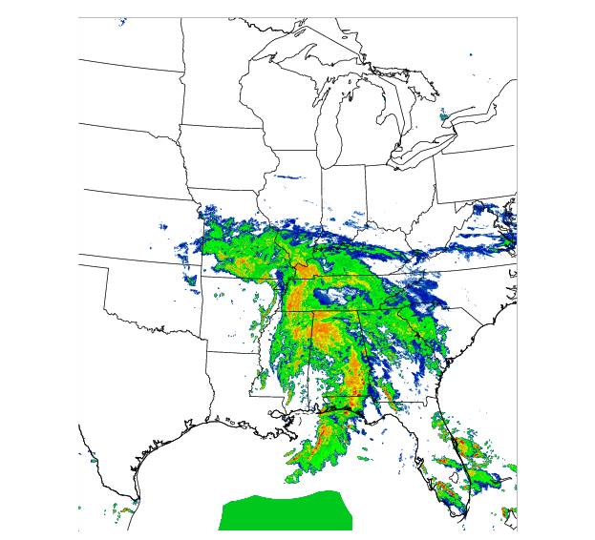
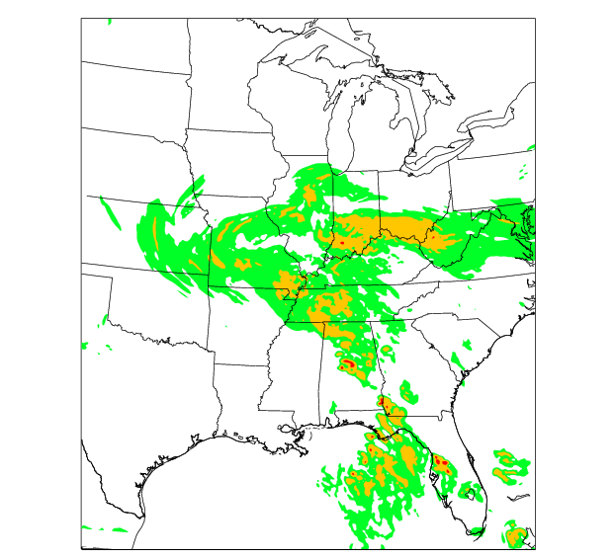
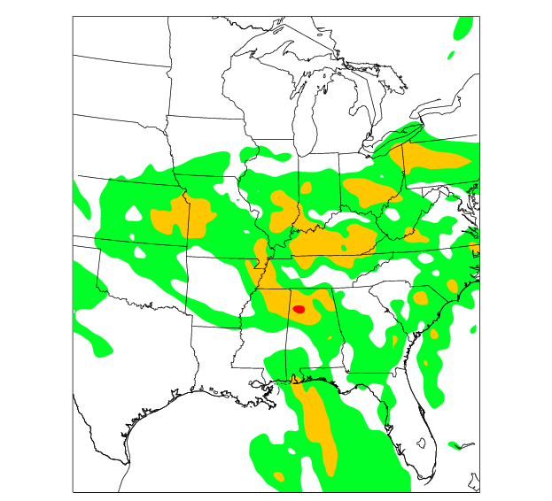
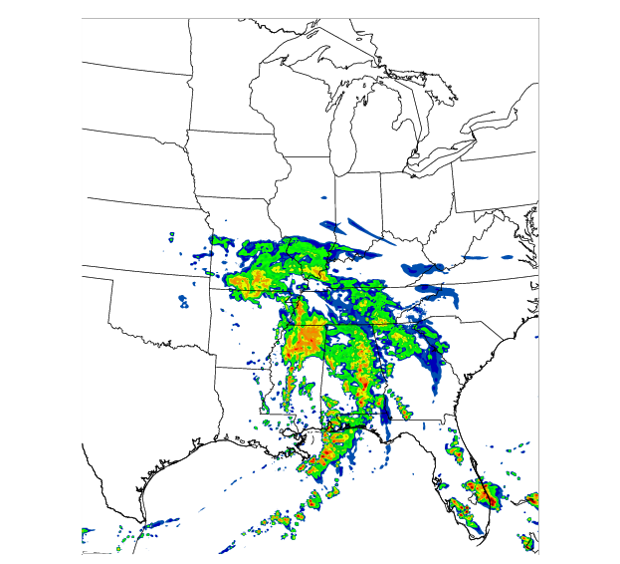
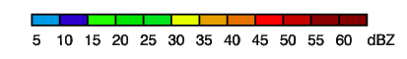
Graphical Turbulence Guidance Enhancements
    Higher HRRR grid resolution resolves convection better
    Adding CIT parameterization:
      Identified CIT diagnostics
      Calibrate diagnostics based on NTDA EDR and in-situ EDR, combined them to ensemble weighted mean in-cloud CIT field
      GTG output contains MAX EDR of MWT,CAT,LLT & CIT
  NSSL Radar Reflectivity Mosaic
  23 April 2018 at 20 UTC, FL 330
  GTG HRRR – 2hr forecast
  GTG RAP – 2hr forecast

Slide 10
NEXRAD/NCAR Turbulence Detection Algorithm
Reflectivity (dBZ) is NOT a reliable indicator of turbulence location
  Airspace outside high-echo regions may be turbulent
  Convective turbulence can be small-scale and evolve quickly
NTDA makes use of NEXRAD radar measured spectrum width
  Undergoes significant data quality control
  Converts radar measurements into EDR (Williams et al. 2016)
  Verified with in situ turbulence measurements and Pireps
NTDA produces 3D mosaic of EDR and confidence:
  5 minute update rate
  2 km horizontal x 3,000 ft vertical resolution

Slide 11
In-Cloud EDR Distribution
In-situ EDR versus NTDA EDR based on data from 2015-2016
Peak of in-cloud EDR distribution shifts to higher EDR
Distribution of EDR in thunderstorms shifts to even higher EDR

Slide 12
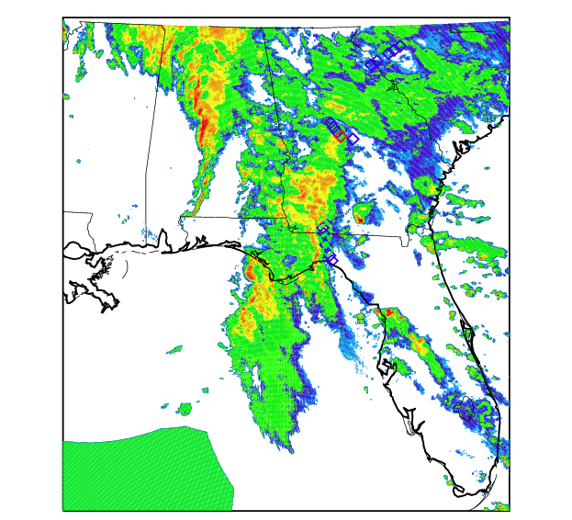
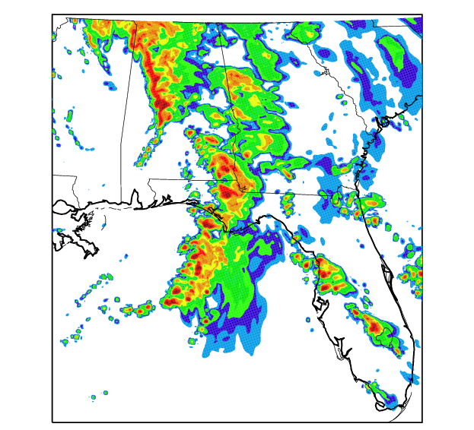
Case Study of in cloud CIT Forecast
23 April 2018, 1 UTC
NSSL Radar Reflectivity Mosaic
HRRR Radar Reflectivity 2 hr forecast

Slide 13
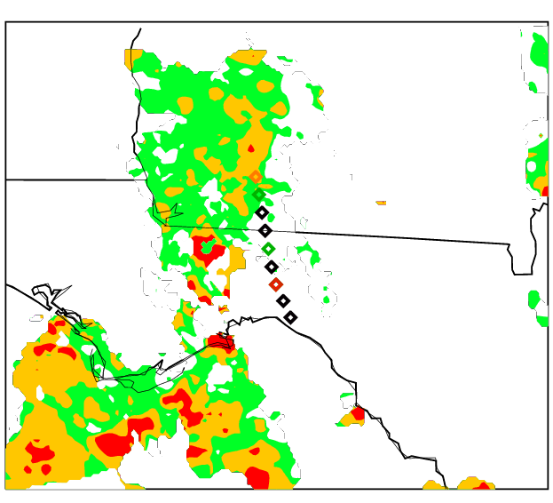
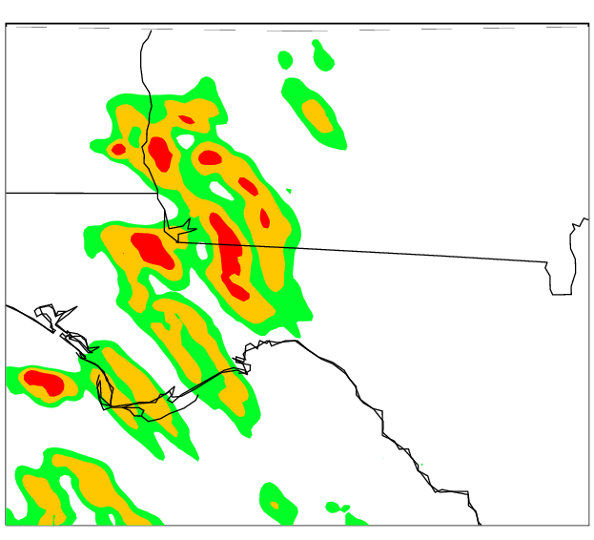
Case Study of in cloud CIT Forecast
23 April 2018, 1 UTC
Max. NTDA EDR and in-situ EDR, FL 330
GTG CIT max. EDR, FL 330

Slide 14

Graphical Turbulence Guidance Nowcast (GTGN)
  Provides short-term forecasts of turbulence
  Uses GTG short-term forecasts nudged with most recent observations to provide 15-min updates of EDR on 3 dimensional grid
  Includes convective turbulence observations (NTDA)
  Includes in situ observations of EDR from airlines
  Currently in demo/evaluation phase and transitioned to operations (AWC, AWDE, DAL)
Pearson & Sharman 2017

Slide 15
GTG and GTGN Deployment Schedule
Version Capabilities Op. date*/enter QA
GTG1 Upper levels 3/2003*
RUC20
GTG2 Improved GTG1 2/11/2010*
+Mid levels
+Uses UAL in situ
GTG2.5 13 km WRFRAP cutout grid 5/1/2012*
+VWA insitu (UAL+DAL)
GTG3.0 13 km RAP conus grids 10/20/2015*
Provides EDR
+ MWT
+ all levels (0-FL450)
+1-18 hrs
GTG-G FV3 + UKMET (merge at AWC) August 2018
0-36 hrs (FY2019*)
Upper-levels only
GTGN 15-min updates, in-cloud CIT FY2020*
GTG4 Improved GTG3 FY2019
+ HRRR 3-km grid (FY2020*)
+ CIT forecasts
+ improved LLT forecasts
GTGN2 Adapted to HRRR FY2021
GTG5 Upgrade to FV3-HRRR FY2022?
GTG6 Improved GTG5 FY2022/2023?
+Ensembles/Probabilistic forecasts
GTG1
GTG4
GTG3
GTG2
GTG4
GTG3
Source: P. Lester, “Turbulence – A
new perspective for pilots,”
Jeppesen, 1994

Slide 16
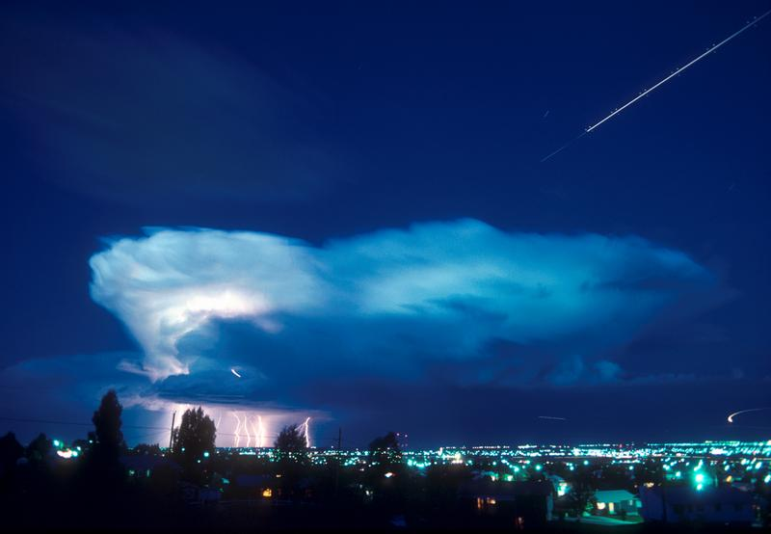
Thank you!
Questions?
This research is in response to requirements and funding by the Federal Aviation Administration (FAA). The views expressed are those of the authors and do not necessarily represent the official policy or position of the FAA.

