Slide 1
DLR’s Wake Vortex and Turbulence Research
F. Holzäpfel, H. Wilms, M. Bramberger, U. Schumann, S. Körner, A. Dörnbrack, C. Schwarz*
Deutsches Zentrum für Luft- und Raumfahrt (DLR)
Institut für Physik der Atmosphäre, Oberpfaffenhofen
*Institut für Flugsystemtechnik, Braunschweig
Germany
Wake Vortex Encounter over the Arabian Sea
Wake Vortex Prediction and Warning Systems − WSVBS, WEAA
Mountain Wave Hazards on Aviation

Slide 2
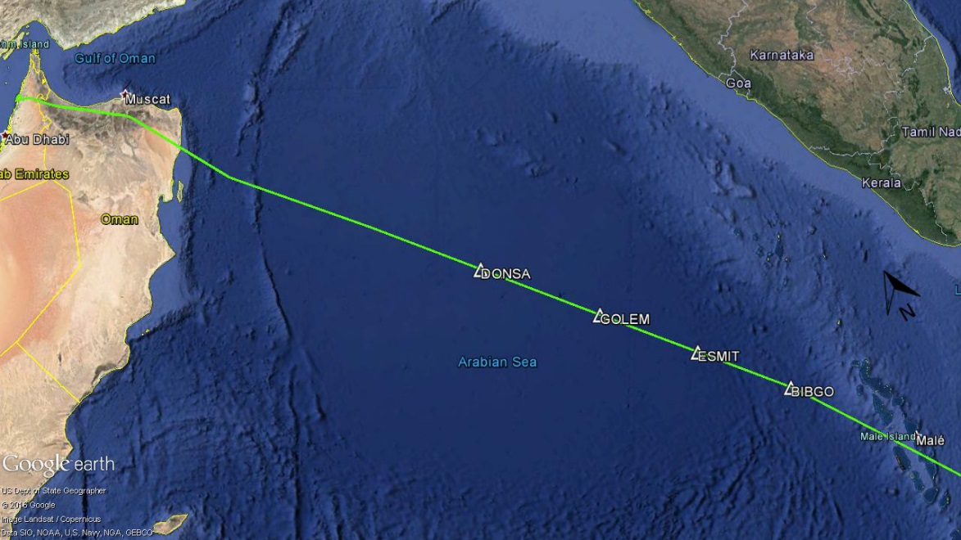
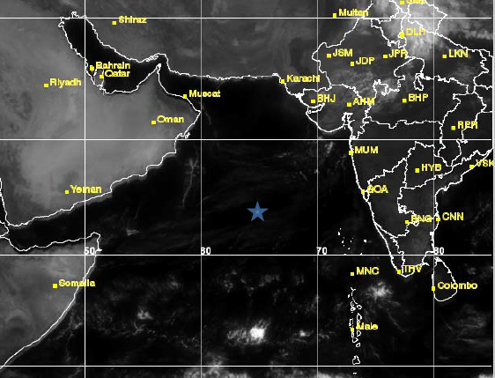
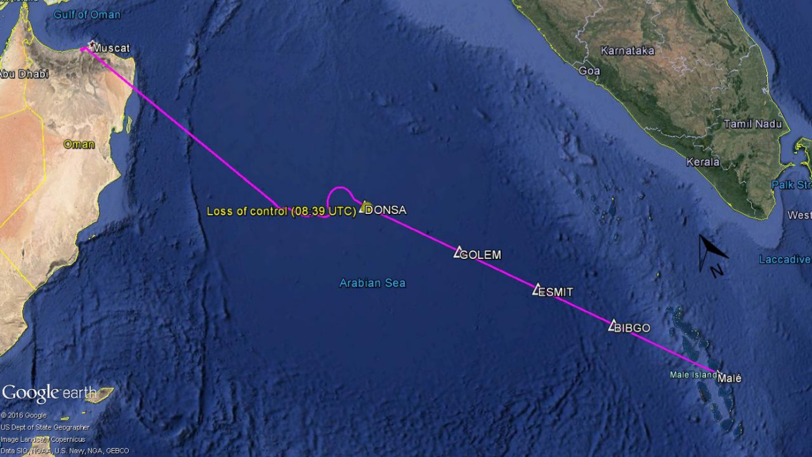
Wake Vortex Encounter over the Arabian Sea encounter situation − 7 Jan 2017, 8:39 UTC
30
flight track A380
20
latitude
10
Arabian Sea
0
50
60
70
80
longitude
flight track CL604
satellite image of visible channels of Indian KALPANA-1 satellite, 8:45 UTC, 7 Jan 2017
6 min after the encounter.
analysis based on interim report of German Federal Bureau of Aircraft Accident Investigation (BFU):
"Bulletin Unfälle und Störungen beim Betrieb ziviler Luftfahrzeuge, Januar 2017,"
Bundesstelle für Flugunfalluntersuchung (BFU), Braunschweig, Germany, 2017, p. 43.
https://www.bfu-web.de/DE/Publikationen/Bulletins/bulletins_node.html
source: BFU
Notes:
Bombardier CL604 was enroute at FL340 from Malé (Maldives) towards an intermediate stop in the United Arab Emirates
A388 from Dubai to Sidney at FL 350

Slide 3
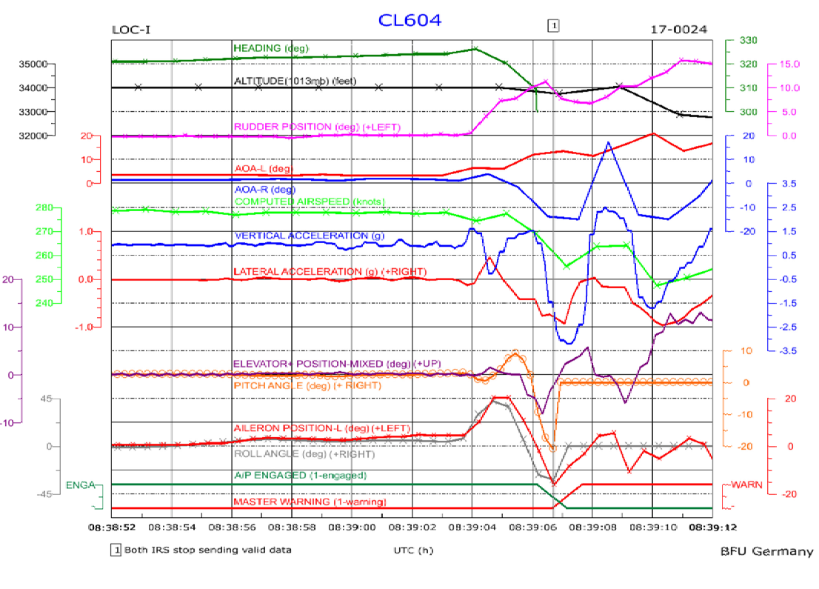
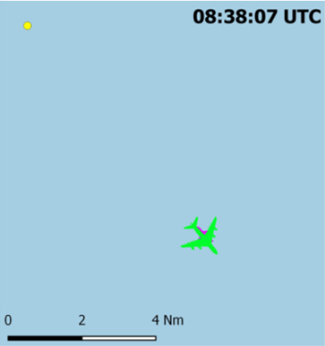
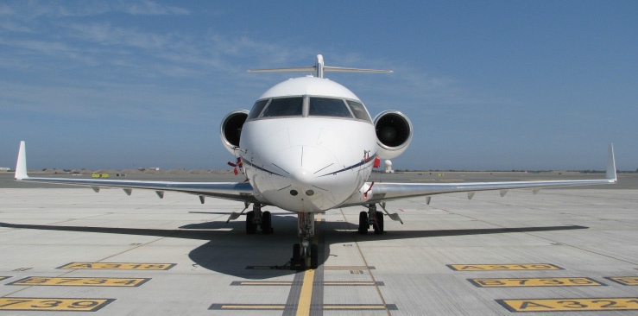
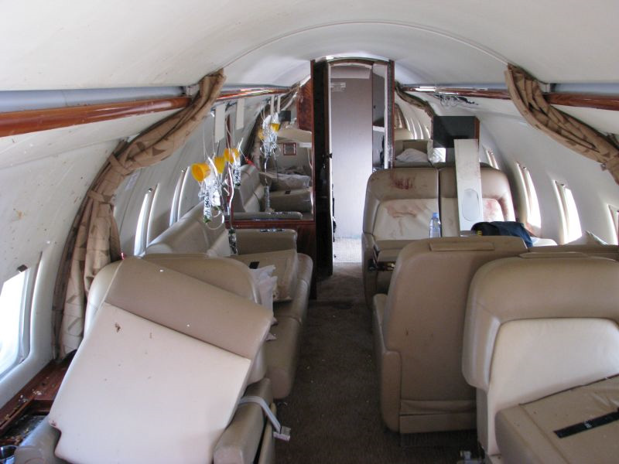
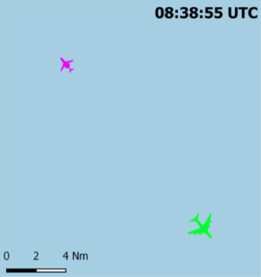
encounter situation − 7 Jan 2017, 8:39 UTC
08:38:55 (1) bank angle right 5°,
aileron deflection left,
fluctuating vertical accelerations
08:39:04 (2) strong a/c response begins
(3) bank angle 42°, aileron 20°,
vertical acceleration 1.6 g
(4) 08:39:06 rolling left -31°,
downwards acceleration -3.2 g,
autopilot shut off, IRS inoperative
⇒ subsequent attitude angles unknown
08:39:09 altitude loss of 2700 m
2
3
2
3
4
1
4
1
Bombardier Challenger CL604
source: BFU
view against flight direction
Notes:
2 passengers heavily injured
2 passengers and flight attendent slightly injured

Slide 4
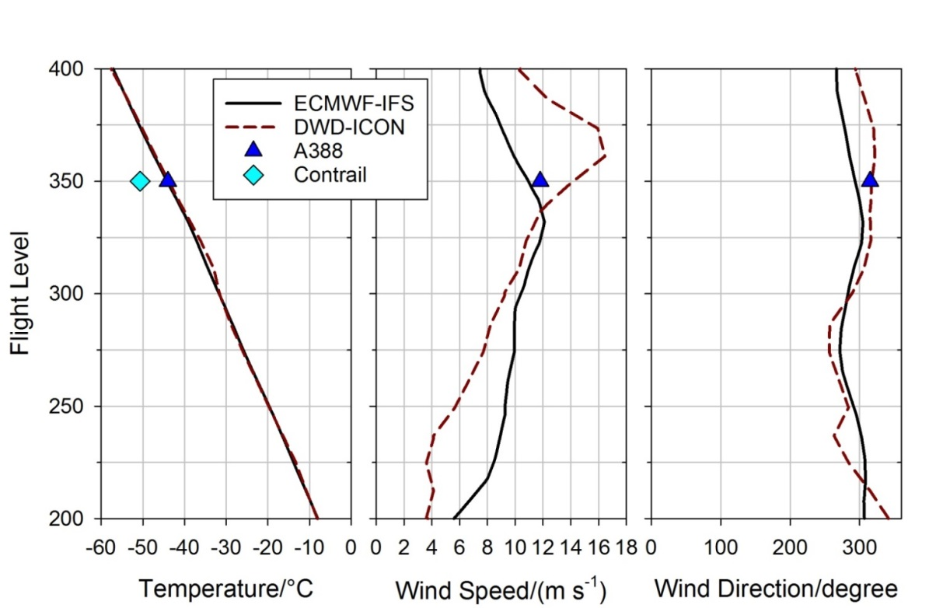
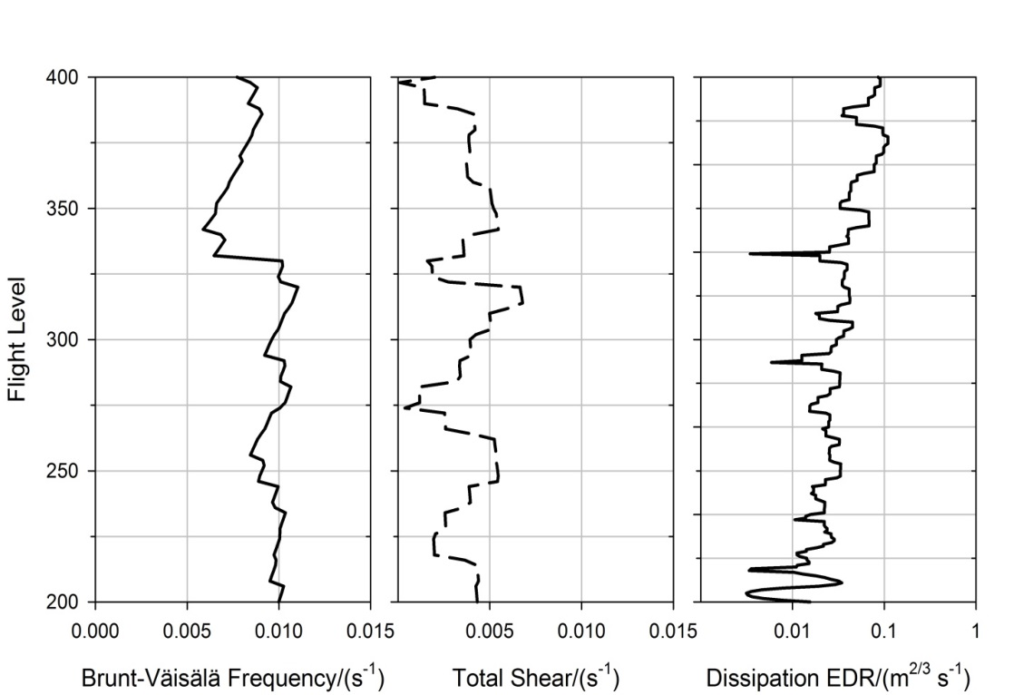
Meteorological Environment
Integrated Forecasting System (IFS) of the European Center for Medium Range Weather Forecasts (ECMWF)
Icosahedral Nonhydrostatic Model (ICON) of the German Weather Service (Regine Zinkhan, DWD)
temperature at FL 350 above contrail threshold
⇒ no visible contrails
derived from ECMWF temperature & wind profiles
Schumann, U., "On conditions for contrail formation from aircraft exhausts," Meteorologische Zeitschrift 5 (1) 1996, pp. 4-23.
U. Schumann, T. Gerz, "Turbulent mixing in stably stratified shear flows," Journal of Applied Meteorology 34 (1) 1995, pp. 33-48.
Notes:
relative humidity below 20%
temperature at FL 350 was about -44°C and, hence, definitely above the “liquid threshold” temperature of -50.6°C for contrail formation at this pressure level
extended Schmidt-Appleman criterion for kerosene (1.23 kg kg⁻¹ water vapor emission index, 43.2 MJ kg⁻¹ combustion heat), for an estimated overall propulsion efficiency 0.35±0.05, and for humidity of 20% over ice.

Slide 5
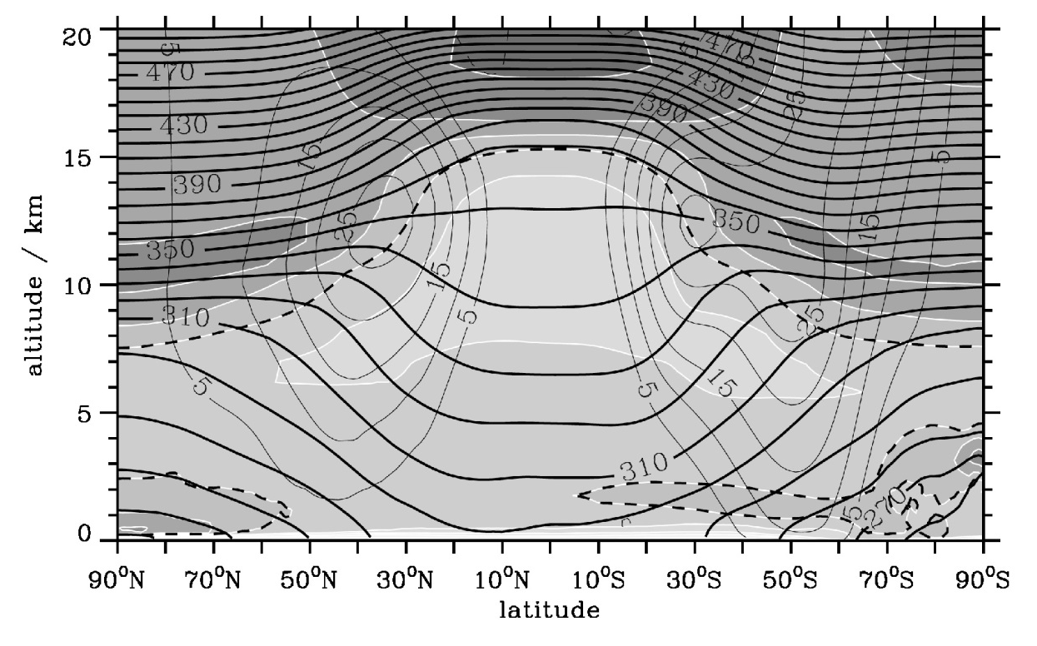
Climatology − Zonal mean potential temperature, wind and Brunt-Väisälä frequency
N = 0.01 s⁻¹
derived from 39 years of ERA-Interim data
Notes:
subtropical jets
0.005 /s < N < 0.0075 /s

Slide 6
Climatology − Zonal mean potential temperature, wind and Brunt-Väisälä frequency
Brunt‐Väisälä Frequency is generally lower in the tropics than in the extratropics
⇒ WV in low-turbulence regions may survive longer and descend deeper in the tropical troposphere than elsewhere!!
N = 0.01 s⁻¹
derived from 39 years of ERA-Interim data

Slide 7
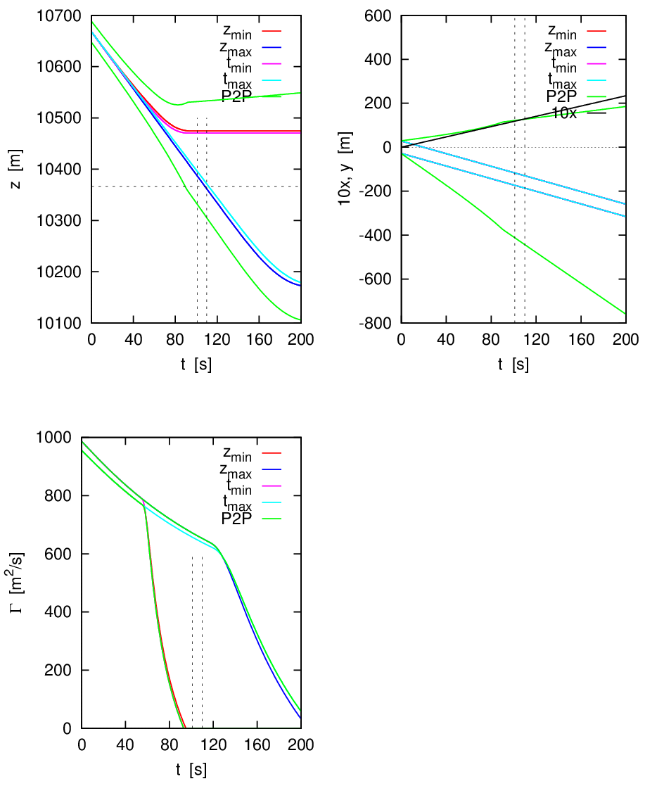
Airborne Probabilistic
2-Phase wake vortex model − P2Pª with A388 wind
& ECMWF data
10% inboard loading
Holzäpfel F. 2003: A Probabilistic Two-Phase Wake Vortex Decay and Transport Model, Journal of Aircraft 40, 323-331.
Holzäpfel F., Robins R.E. 2004: Probabilistic Two-Phase Aircraft Wake-Vortex Model: Application and Assessment, J. Aircraft 41, 1117-1126.
Holzäpfel F. 2006: Probabilistic Two-Phase Aircraft Wake-Vortex Model: Further Development and Assessment, J. Aircraft 43, 700-708.

Slide 8
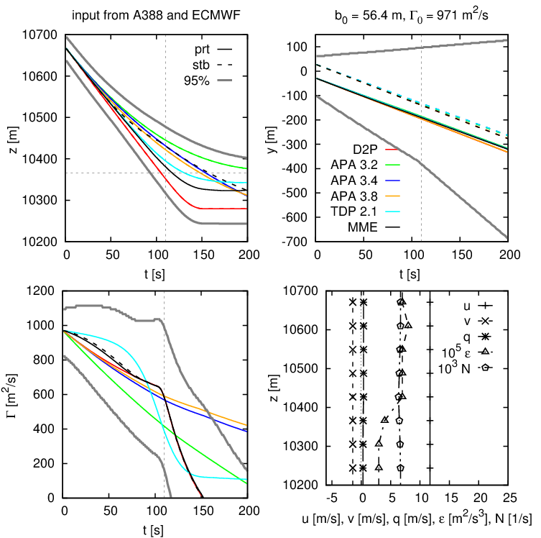
Multi-model ensemble wake vortex prediction
combining WV models of NASA and DLR
A388 wind & ECMWF data for vortex decay
10% inboard loading
descent between
MME & D2P
S. Körner, F. Holzäpfel, “Multi-Model Wake Vortex Prediction”, Aircraft Engineering and Aerospace Technology 88 (2) 2016.
http://dx.doi.org/10.1108/AEAT-02-2015-0068
S. Körner, N.N. Ahmad, F. Holzäpfel, R.L. Van Valkenburg: MultiModel Ensemble Methods for Prediction of Wake-Vortex Transport and Decay, J. Aircraft 54 (5) 2017, 1849-1859. http://dx.doi.org/10.2514/1.C034287

Slide 9
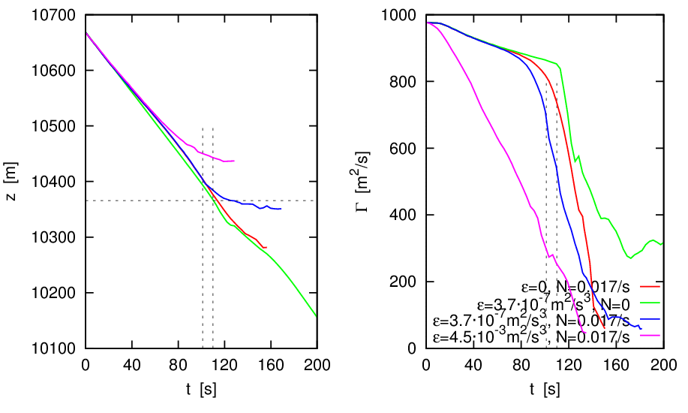
Results of highly resolved numerical simulations (LES)
scaled to A388 vortices (10% inboard loading)
vortex rings
keep descending
in neutral stratification
T. Misaka, F. Holzäpfel, T. Gerz, M. Manhart, F. Schwertfirm, Vortex bursting, tracer transport, and decay mechanisms of a counter-rotating vortex pair, Physics of Fluids 24 (2) 2012, 25104-1 - 25104-21, doi: 10.1063/1.3684990

Slide 10

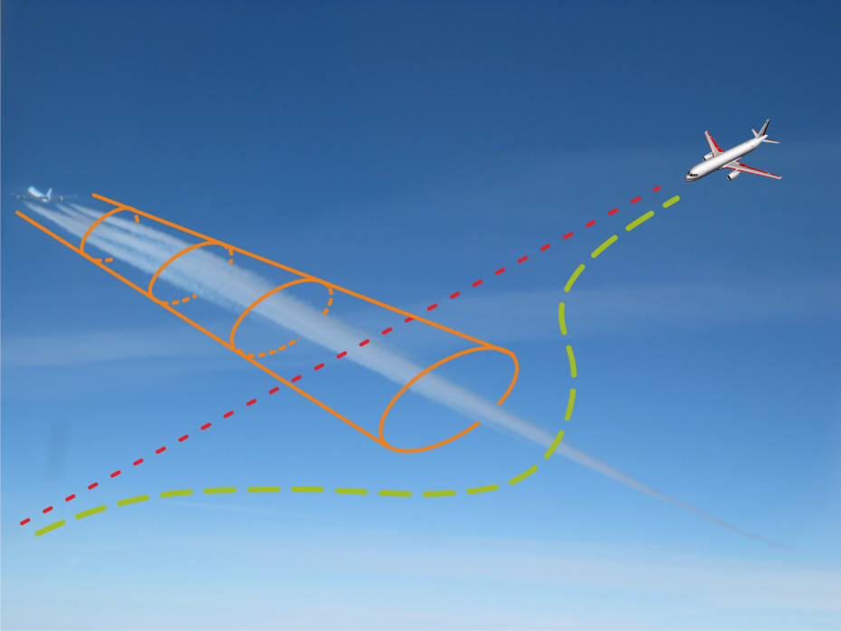
Wake Encounter Avoidance & Advisory (WEAA)
airborne information and warning system
prevention of dangerous wake vortex encounters
in all phases of flight
functionality as safety net / assistance system (increase of situational awareness)
identification of a predicted, imminent or even current wake vortex encounter
resolution of conflict by recommendation of tactical small-scale evasion manoeuvres
T. Bauer et al., "In-Flight Wake Encounter Prediction with the Wake Encounter Avoidance and Advisory System," AIAA 2014-2333, 2014.
doi: 10.2514/6.2014-2333
Notes:
Pure safety net function, keine Neukategorisierung etwa nur durch System
auch Identifikation gegenwärtiger Einflüge: Pilotenwunsch zum Systembewusstsein (Ausschluss von System- und Sensorfehlfunktionen)

Slide 11
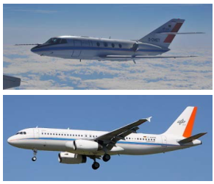
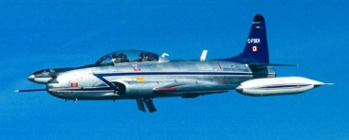
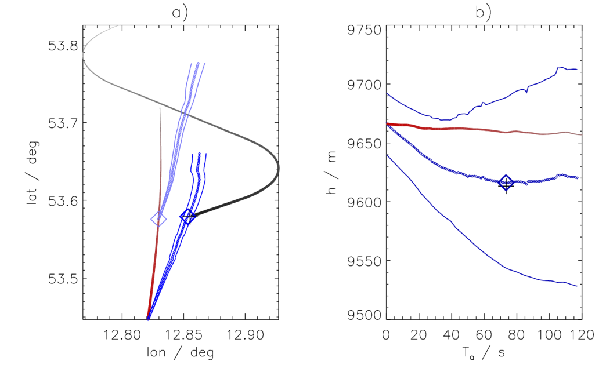
Wake Encounter Avoidance & Advisory (WEAA)
flight tests in April 2014 and Nov/Dec 2016
with DLR‘s Falcon and ATRA
new tests planned with NRC‘s T33 (WAVE App)
encounter on 11/04/2014
I. Sölch et al. “Performance of on-board wake vortex prediction system employing various meteorological data sources”, J. Aircraft 53 2016. DOI: 10.2514/1.C033732

Slide 12
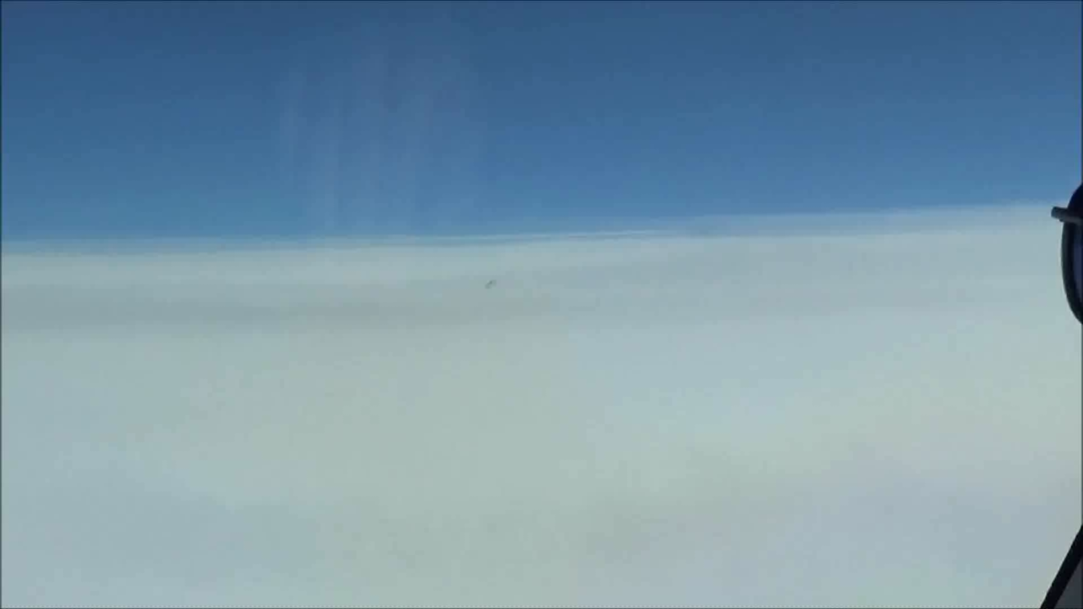
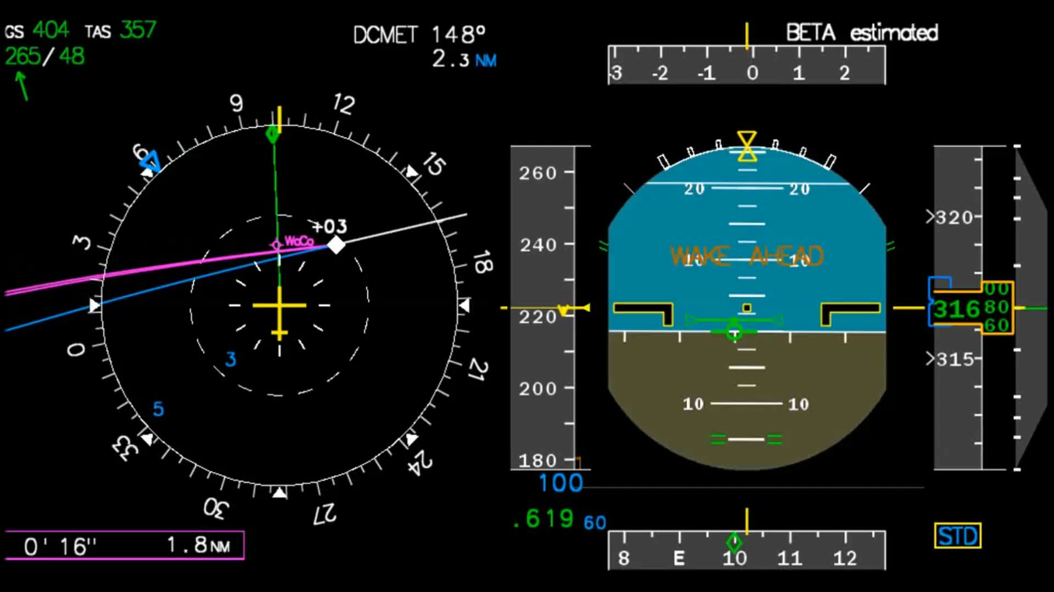
WEAA Encounter Video
www.DLR.de • Slide 12
Notes:
oben clicken

Slide 13
meteo measurements
SODAR/RASS USA
3 gates, 0.3 - 1 NM
numerical weather pred.
COSMO-Airport
10 gates, 2 - 11 NM
optionally a/c type comb.
Flight Plan
a/c type, arrival time
glide path adherence statistics
FLIP
standard deviations in 13 gates
wake-vortex prediction
P2P
envelopes for y(t), z(t), Γ(t) in
13 gates for individual pairings
WSVBS
safety area prediction
SHAPe
ellipses for individual followers
wake-vortex monitoring
LIDAR
3 planes, 0.3 - 1 NM
temporal a/c separations
for individual
conflict detection
validation of vortex predictions
procedures
AMAN
STG, MSR, MSL, ICAO
Wake-Vortex Prediction & Monitoring System WSVBS

Slide 14
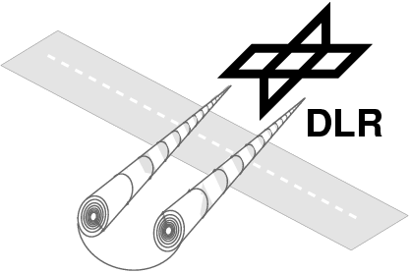
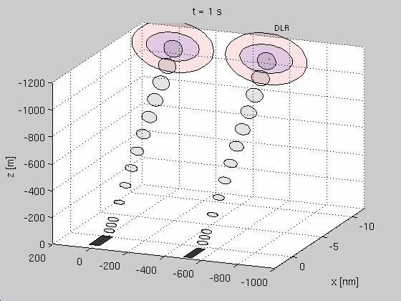
WSV Strategy
Animated strong crosswind
modified staggered left
reduced sep. single rwy
F. Holzäpfel, T. Gerz, M. Frech, A. Tafferner, F. Köpp, I. Smalikho, S. Rahm, K.-U. Hahn, C. Schwarz, The Wake Vortex Prediction and Monitoring System WSVBS Part I: Design, Air Traffic Control Quarterly, Vol. 17, No. 4, 2009, pp. 301-322. https://doi.org/10.2514/atcq.17.4.301
T. Gerz, F. Holzäpfel, W. Gerling, A. Scharnweber, M. Frech, K. Kober, K. Dengler, S. Rahm, The Wake Vortex Prediction and Monitoring System WSVBS Part II: Performance and ATC Integration at Frankfurt Airport, Air Traffic Control Quarterly, Vol. 17, No. 4, 2009, pp. 323-346. https://doi.org/10.2514/atcq.17.4.323
F. Holzäpfel, K. Dengler, T. Gerz, C. Schwarz, Prediction of Dynamic Pairwise Wake Vortex Separations for Approach and Landing, AIAA Paper 2011-3037, 3rd AIAA Atmospheric Space Environments Conference, 27-30 June 2011, Honolulu, Hawaii, 15 pages.

Slide 15
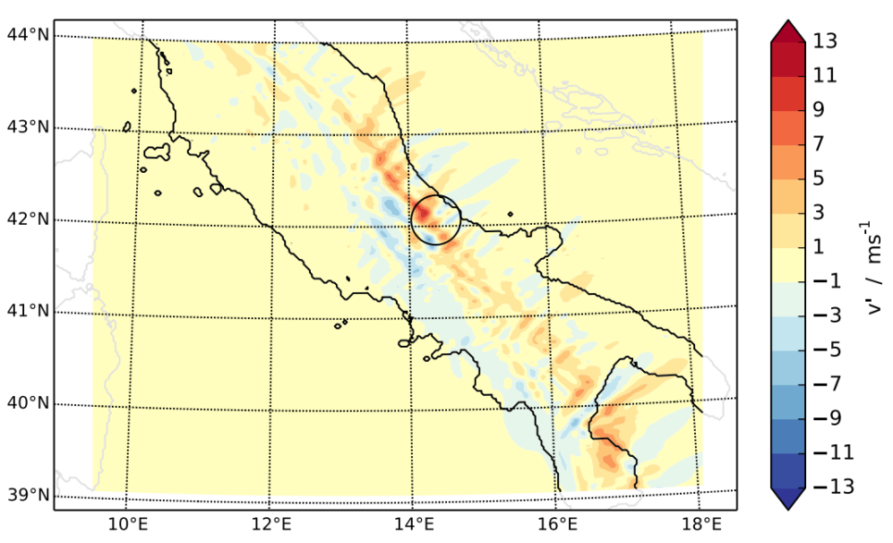
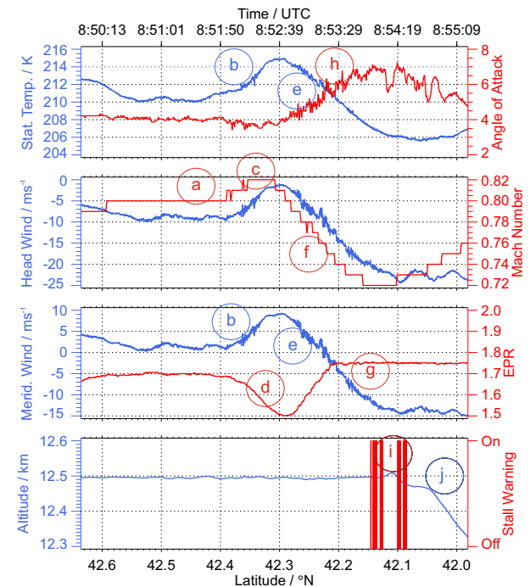
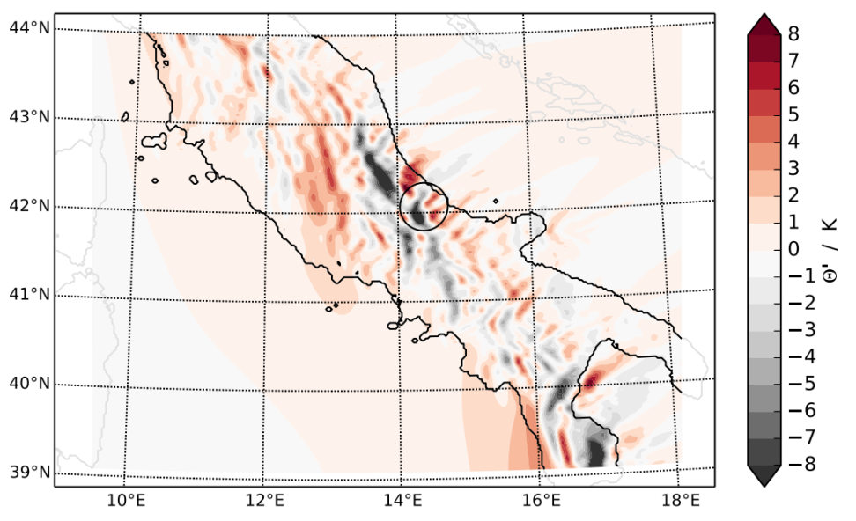
Mountain Wave (MW) Hazards on Aviation
Propagating MWs
Case study on stall warning event of the DLR research aircraft HALO caused by vertically propagating MWs
  In situ aircraft measurements
    characterisation of MWs (amplitudes, wavelength, energy- &
    momentum fluxes)
    Comparison to ECMWF and WRF forecasts
  Numerical simulations
    3D idealized simulations to analyse relevant processes
    Attribution of measured fluctuations to propagating MWs
Bramberger et al., 2018, JAMC
Notes:
Case study on HALO stall event:
- Plot shows in situ and back box data, including stick shacker indicating stall warning
- stall warning was precedented by strong gradients in temperature and along track wind, caused stall warning
- with the help of idealized 3D simulations (EULAG), these fluctiations were attributed to propagating MWs
- comparison with ECMWF showed that these amplitudes were not forecasted

Slide 16
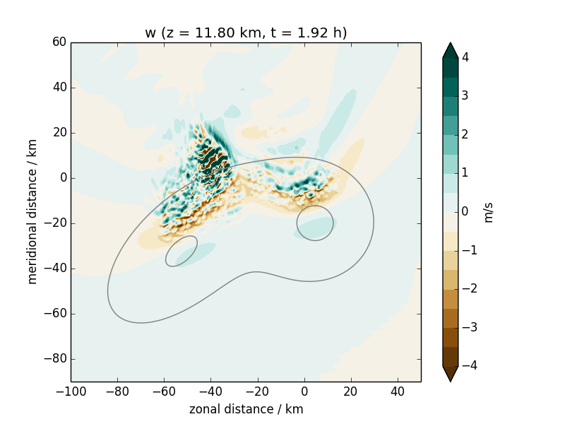
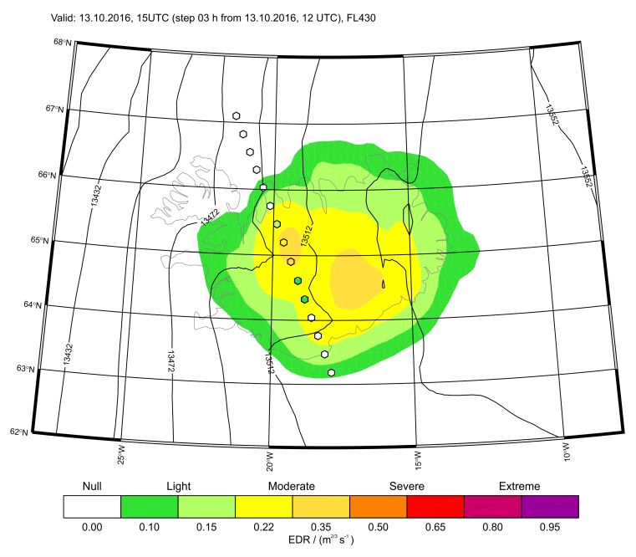
Mountain Wave (MW) Hazards on Aviation
MW Turbulence
Case study on MWT encounter of HALO above Iceland in lower stratosphere
  In situ aircraft measurements
    Calculation of TKE and EDR
    Comparison to turbulence diagnostics based on ECMWF (GTG) and WRF
  Numerical simulations
    Identification of MW breaking as cause for strong turbulence
    Possible intensification of turbulence due to superposition of MWs
under preparation:
Bramberger et al.: Impact of model resolution on MWT predictability
Wilms et al.: Intensification of MWT due to superposition of MWs
Notes:
Bild 1: GTG EDR prediction of MWT; small colored dots: HALO in situ measurements of EDR
Bild 2: EULAG simulation of turbulence event with simplified topography, shows vertical wind, including small scale fluctuations cause by interaction of two mountain waves

Slide 17
Further Research Topics
Focus on MW turbulence and predictability
Plans for analyzing turbulence distribution along jets
Large dataset available from former research campaigns with high quality in-situ meas.
  Further case studies
  Statistical analysis of turbulence distribution
Collaborations:
  German Weather Service (DWD): Turbulence forecasts with ICON
  LITOS (balloon based turbulence measurements in the stratosphere)
Optical turbulence: first study started using GTG for planning of astronomical observations (Uni Durham)
Interested in EDR measurements from commercial aircraft
Strong interest in collaboration for measurement campaigns
(martina.bramberger@dlr.de, henrike.wilms@dlr.de)

Slide 18
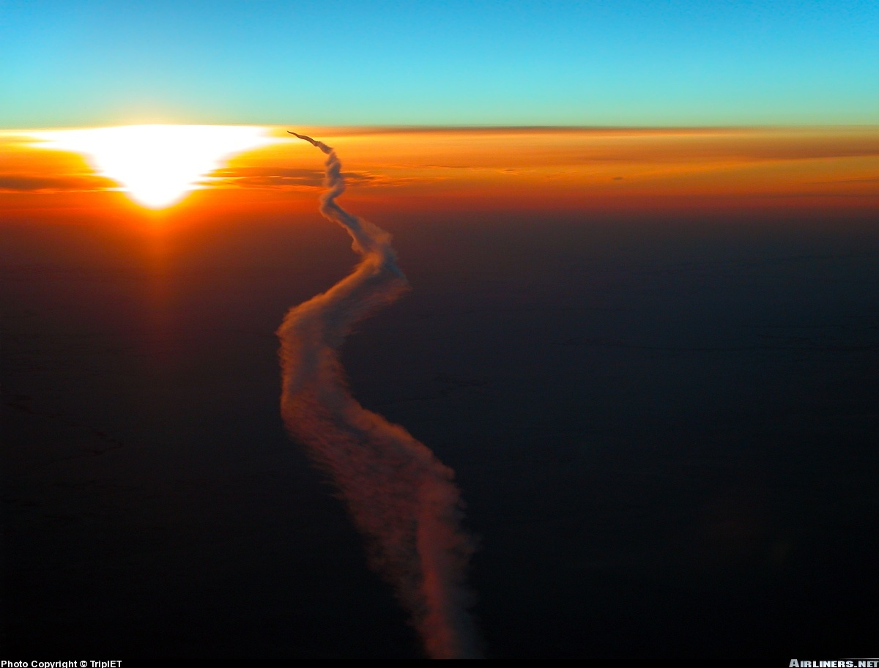
wishing you always smooth and safe flights

Slide 19
Conclusions
accident cannot be explained by meteorological disturbances
no contrails formed that could have warned the pilots
WV encounter appears plausible employing different methods (P2Pª, MME, LES)
assuming root loading of the A388 (10% reduced b₀)
encounter occurs right before onset of rapid decay such that A388 vortices are still very strong
vortex deformation according to Crow instability close to vortex linking
WV descend deeper & live longer in tropics than at mid-latitudes due to weaker thermal strat.
DLR’s WEAA System might have avoided the encounter
initial vortex spacing highly relevant for prediction skills of fast-time models
more detailed analysis will be published after release of final BFU report

Slide 20
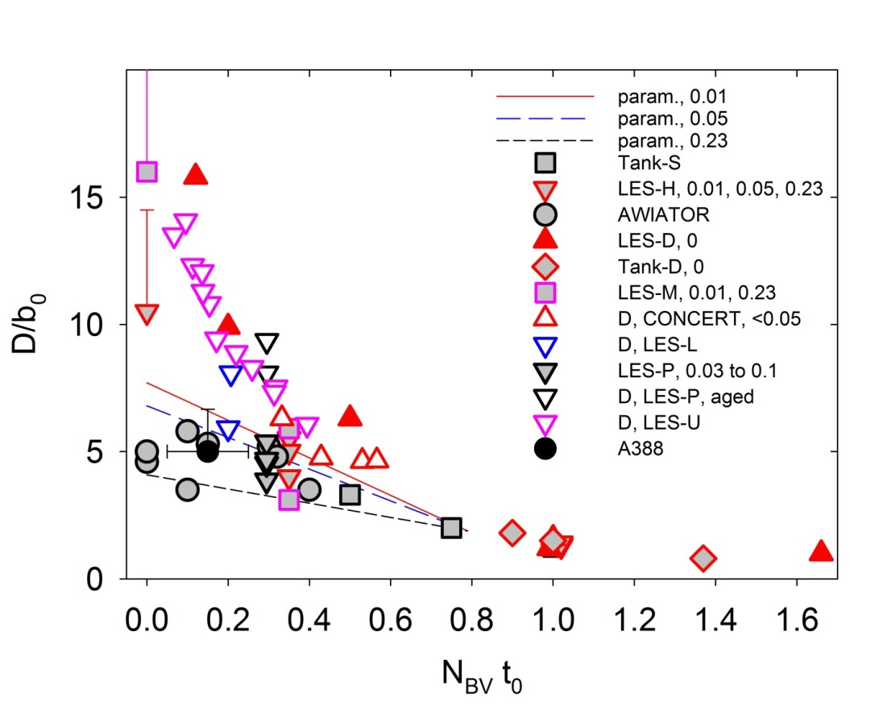
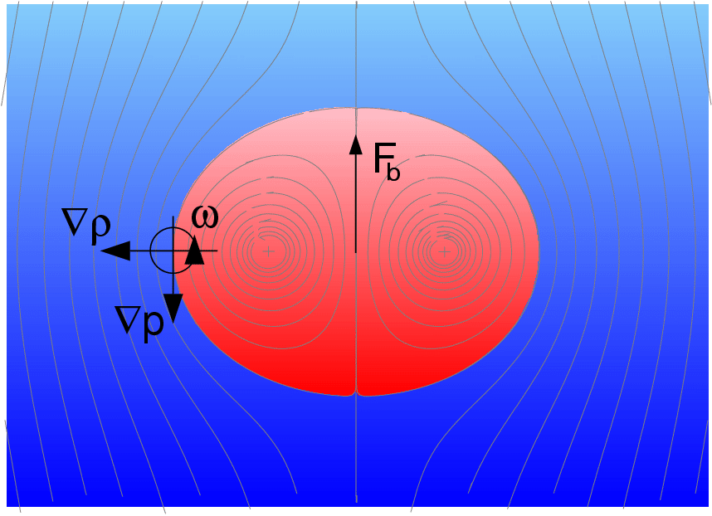
Vortex descent and Brunt-Väisälä frequency, N_{BV}
wake vortex descent distance¹
bouyancy force
¹U. Schumann, A. Heymsfield, "On the lifecycle of individual contrails and contrail cirrus," Meteorological Monographs 58 (3) 2017, 3.1-3.24,
doi: 10.1175/AMSMONOGRAPHS-D-16-0005.1

Slide 21
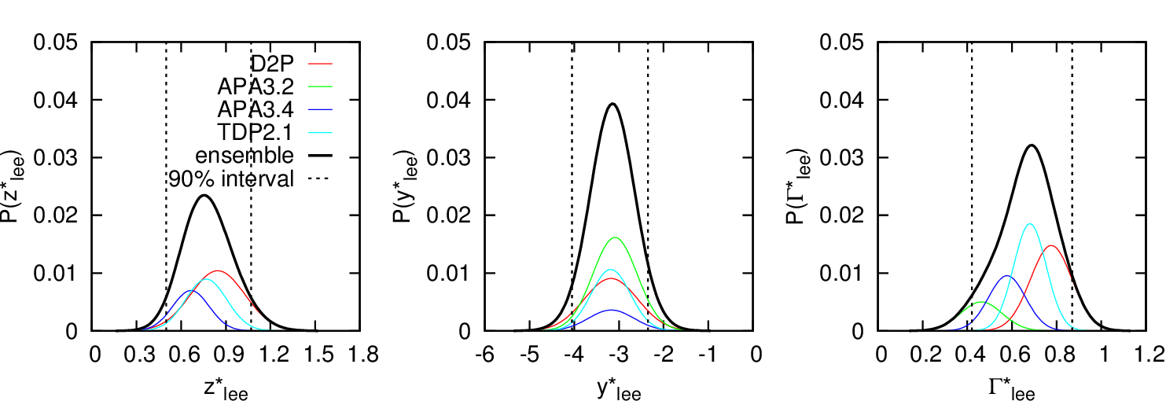
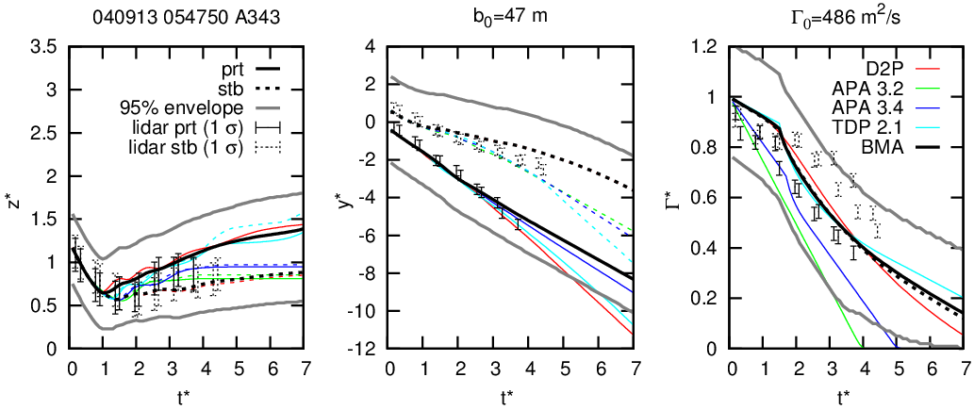
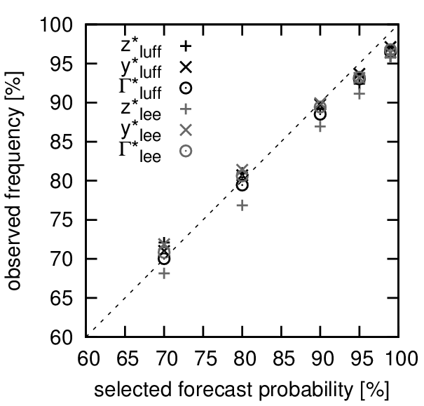
Multi-model ensemble wake vortex prediction combining WV models of NASA and DLR
Bayesian Model Averaging
S. Körner, F. Holzäpfel, “Multi-Model Wake Vortex Prediction”, Aircraft Engineering and Aerospace Technology 88 (2) 2016.
http://dx.doi.org/10.1108/AEAT-02-2015-0068
S. Körner, N.N. Ahmad, F. Holzäpfel, R.L. Van Valkenburg: MultiModel Ensemble Methods for Prediction of Wake-Vortex Transport and Decay, J. Aircraft 54 (5) 2017, 1849-1859. http://dx.doi.org/10.2514/1.C034287

