Slide 1
Turbulence Impact Mitigation Workshop 3
Next Generation World Area Forecast System Turbulence Forecasts
Presented by Claire Bartholomew, WAFC London and
Matt Strahan, WAFC Washington

Slide 2
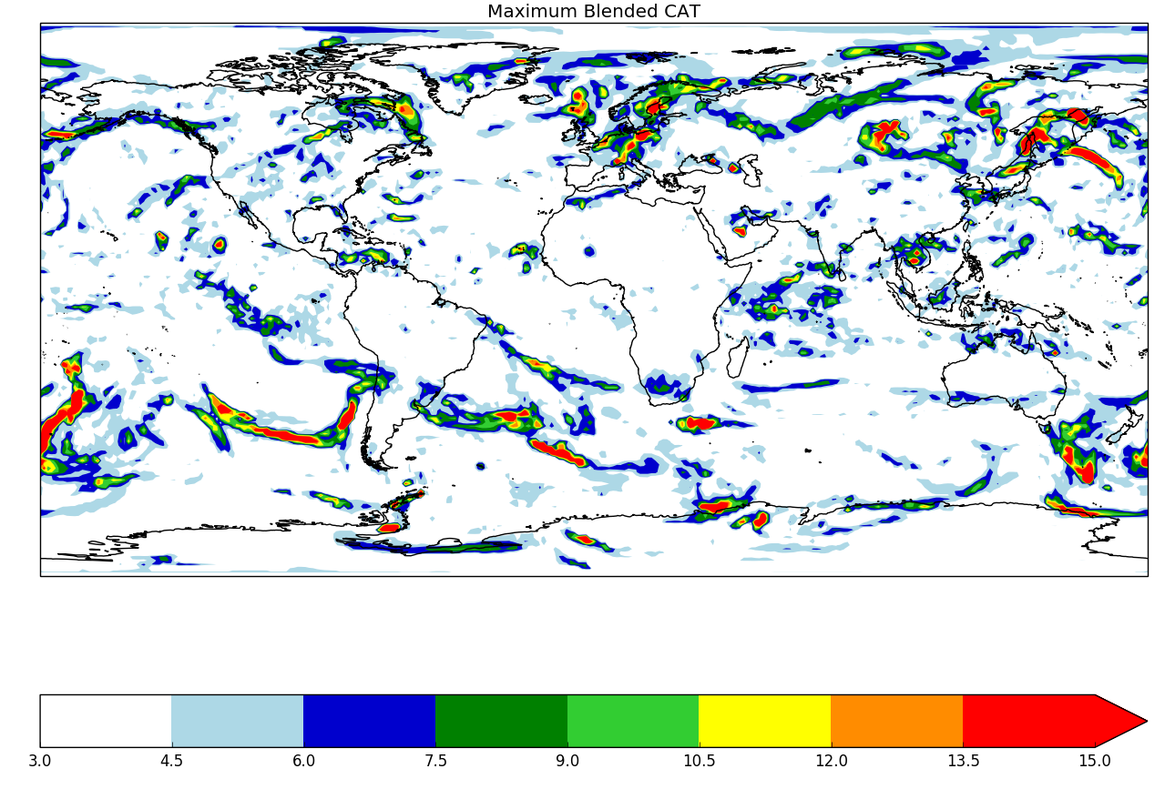
Current WAFS Turbulence Product
Two provider states, WAFC London and WAFC Washington
Max and a mean turbulence “potential”
1.25 degree horizontal resolution grid. T+6 to T+36 3 hour time steps

Slide 3
WAFS Improvement Schedule
2020
Turbulence Severity (EDR)
Horizontal resolution increased to 0.25 degrees
2022
Temporal resolution T+6 to T+24 in 1 hour increments
Temporal resolution T+27 to T+48 in 3 hour increments
2024
Probabilistic Severity (EDR)

Slide 4
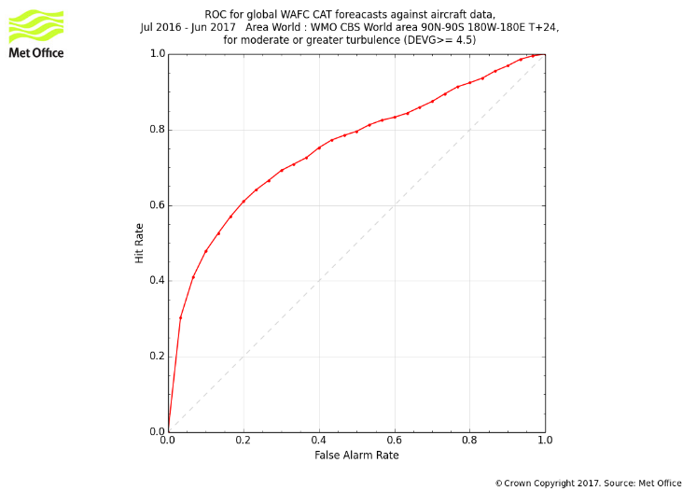
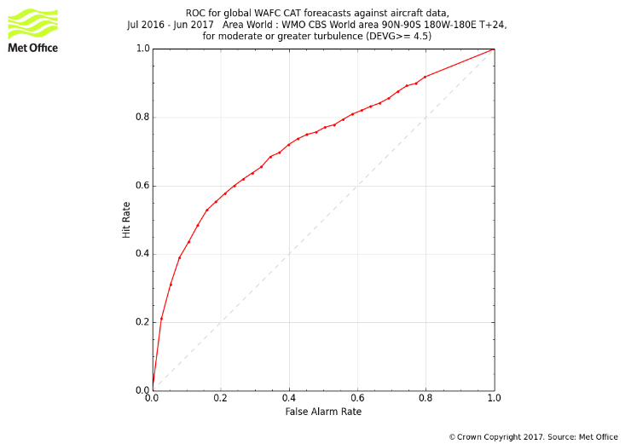
ROC Plots of GTG vs current WAFS
WAFS
GTG
GTG fractionally higher but this is lower resolution ensemble data (control).
Next trial (underway) uses (~10km) global deterministic data

Slide 5
Turbulence Climatology: AIM
To generate MOG turbulence climatology using database of automated aircraft observations
To attempt identification of turbulence events generated by convection and mountain waves, and start to build a climatology of these
Study will ultimately aim:
To identify areas where MOG turbulence is more likely, for use in the aviation community
To provide a basis for future studies of turbulence
To aid future development of turbulence indicators

Slide 6
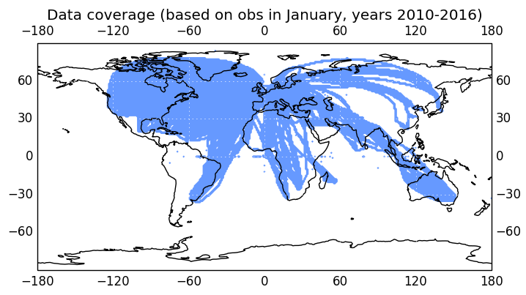
Aircraft observational data used
Archive of automated aircraft measurements
  Global Aircraft Data Set (GADS) – aircraft observations
  ~13 years worth of data available, but need to re-quality control the data for use. Currently 7 years of data has been re-qc’ed
  Data includes vertical
  acceleration, from which
  DEVG is calculated
  Main area of coverage
  indicated below:

Slide 7
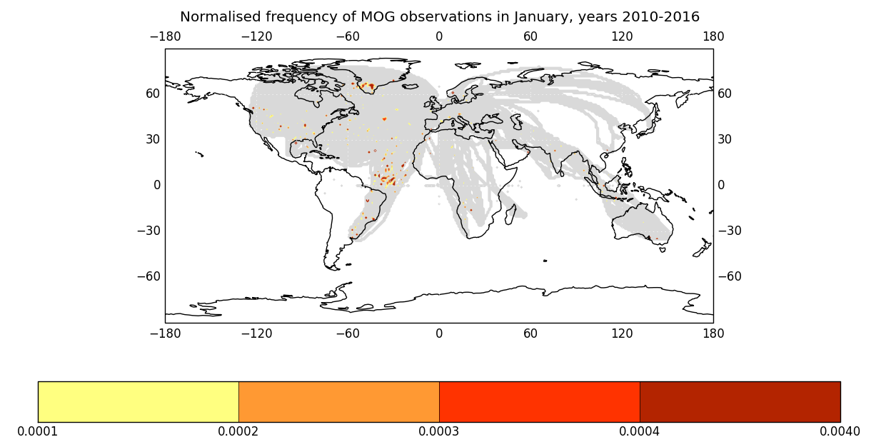
Percentage of Turbulence Obs that are
Moderate or Greater (MOG)
Calculation of (total number of MOG obs)/(total number of obs) in a 1º x 1º grid square
For each month and season
for 7 years
Initial results for
January 2010-2016:

Slide 8
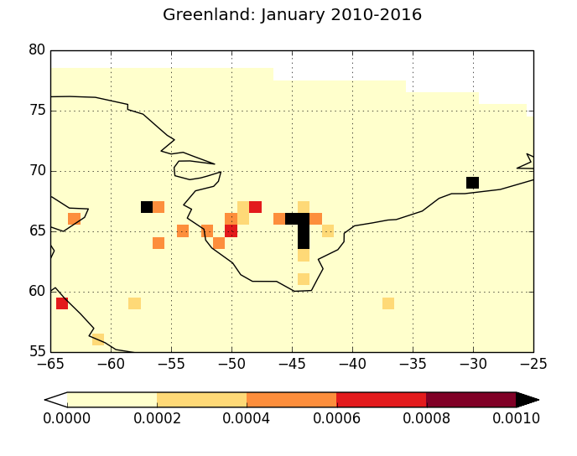
Turbulence Hotspots
- Greenland

Slide 9
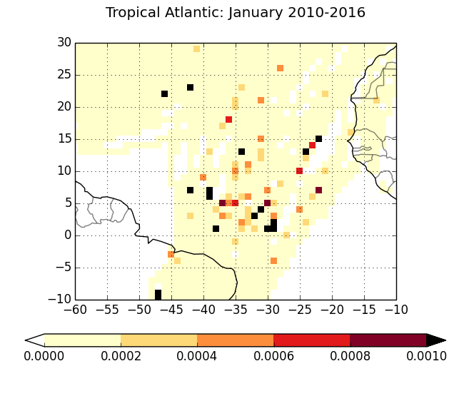
Turbulence Hotspots
-Tropical Atlantic

Slide 10
Next Steps
Combining with other airlines data
Using to verify WAFS turbulence diagnostic
Further QC of more recent aircraft observations

Slide 11
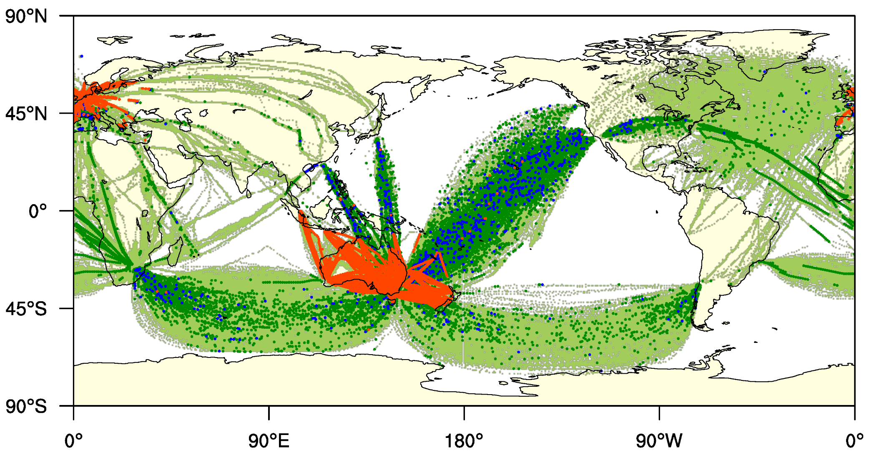
Issues on quality of AMDAR data
Includes below FL280
Includes “bad” aircraft
Problems with positioning
Spurious severe reports
Credit:
Soo-Hyun Kim
Yonsei University

Slide 12
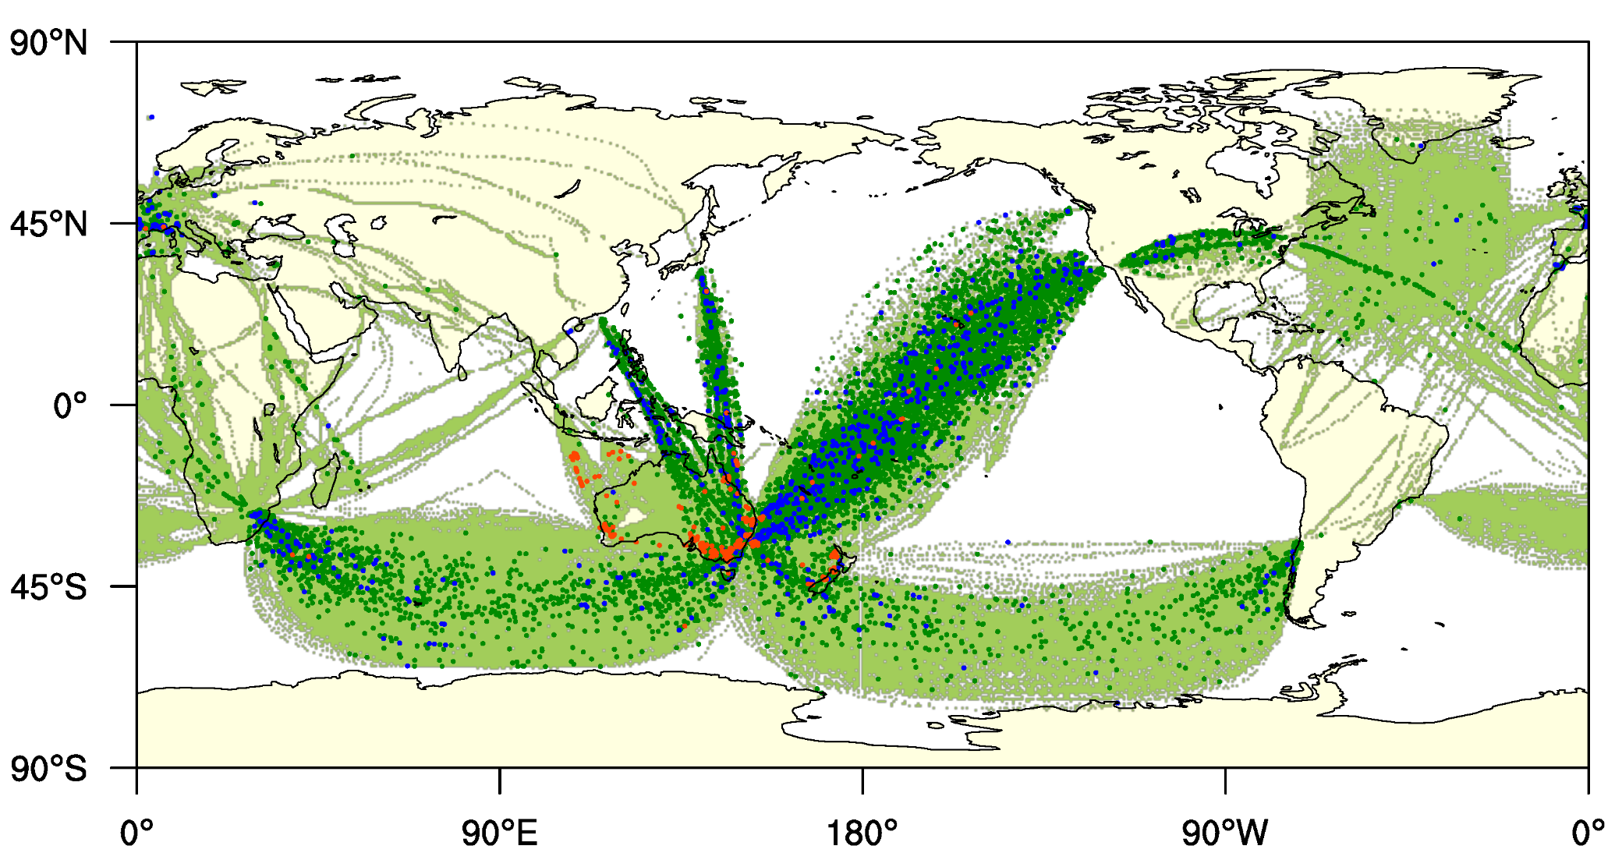
After Quality Control
Credit:
Soo-Hyun Kim
Yonsei University

Slide 13
Importance of the EDR tuning
Ellrod3
Uncalibrated
Ellrod3
Calibrated

Slide 14
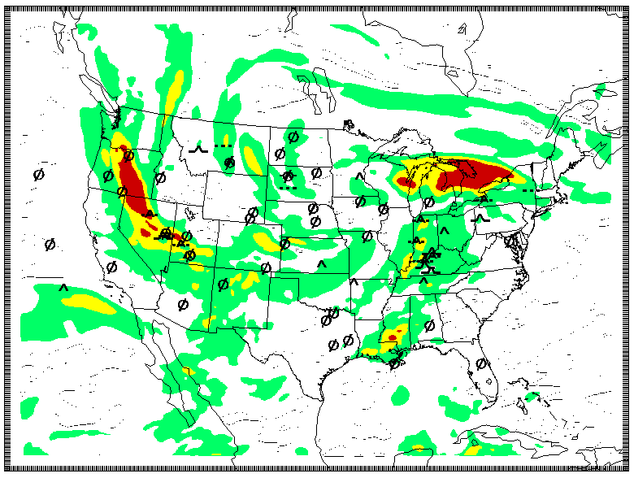
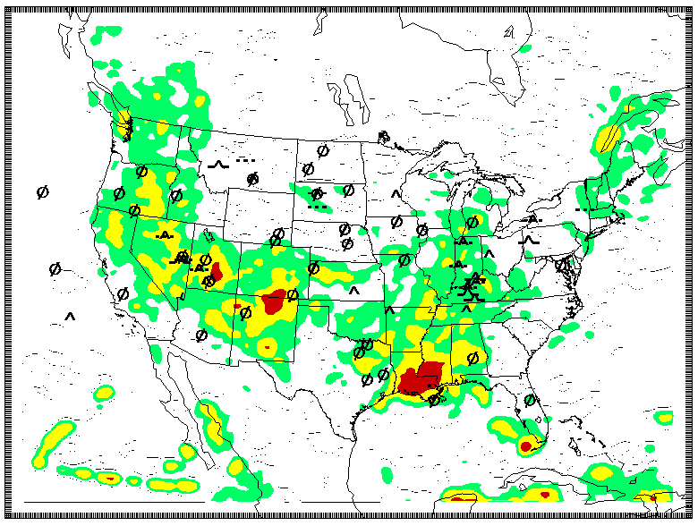
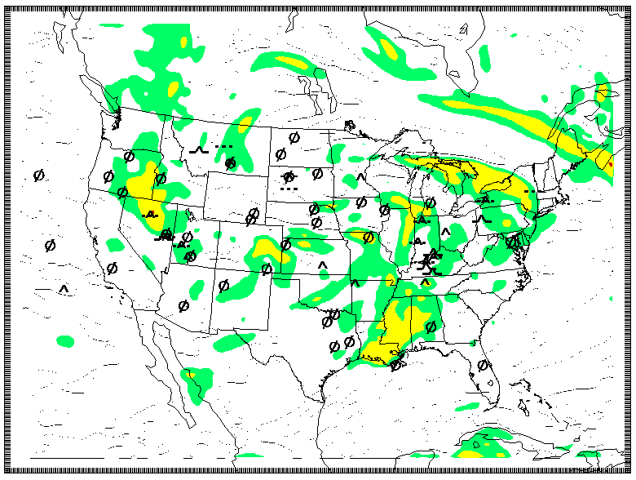
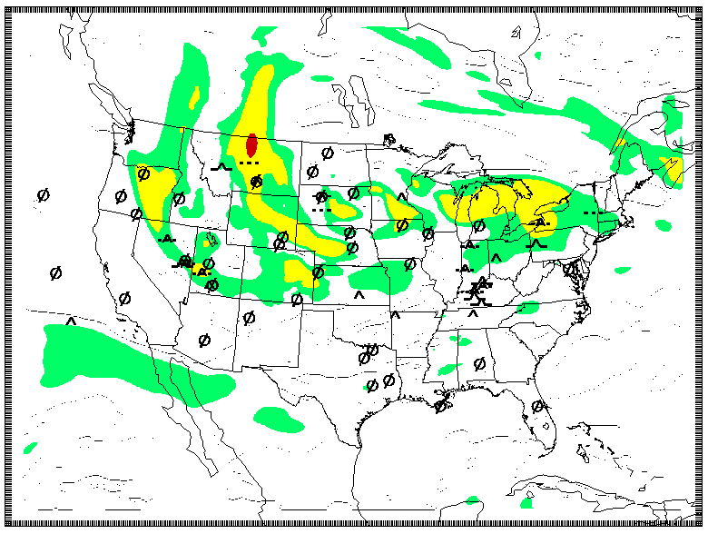
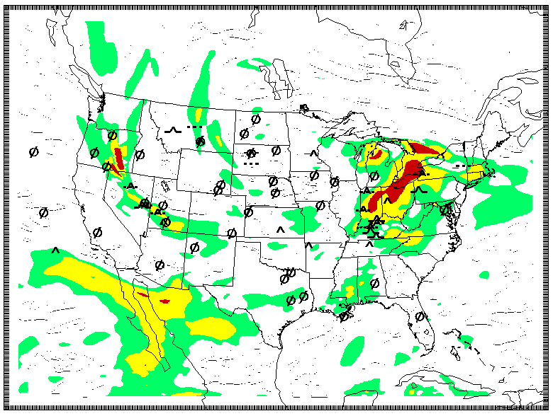
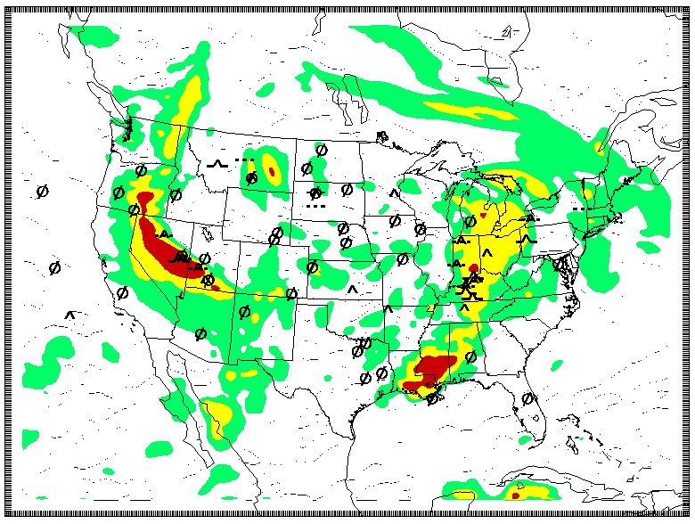
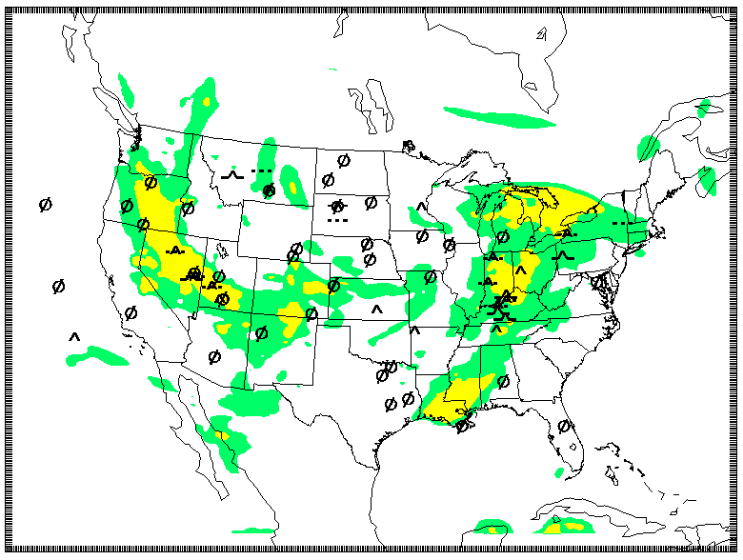
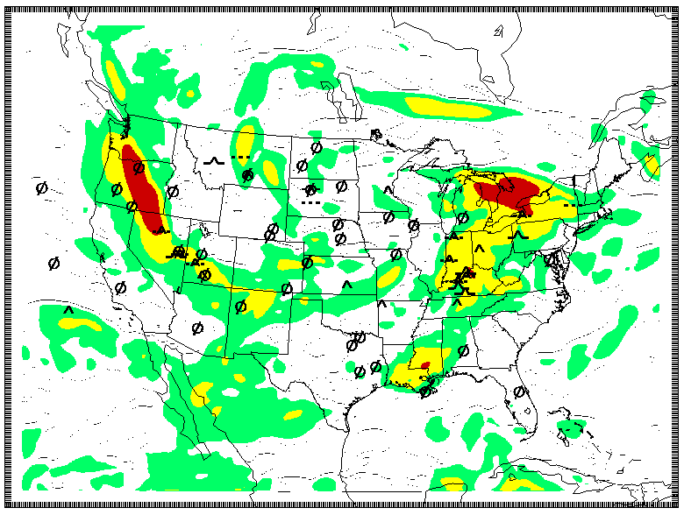
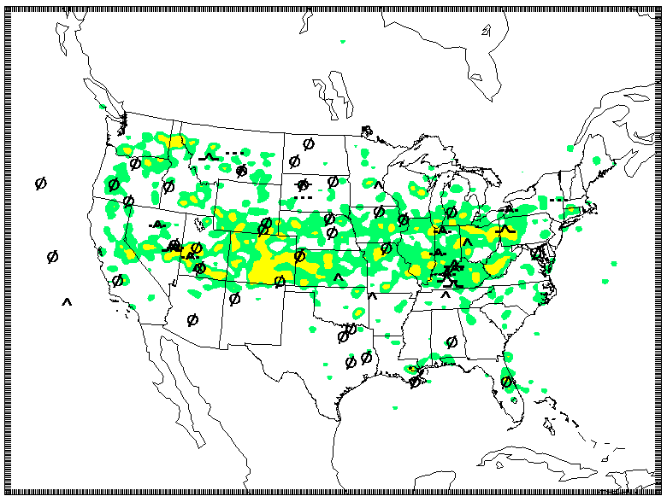
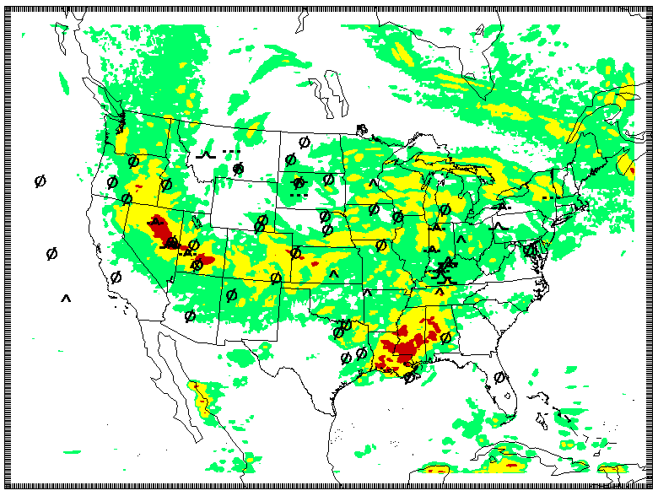
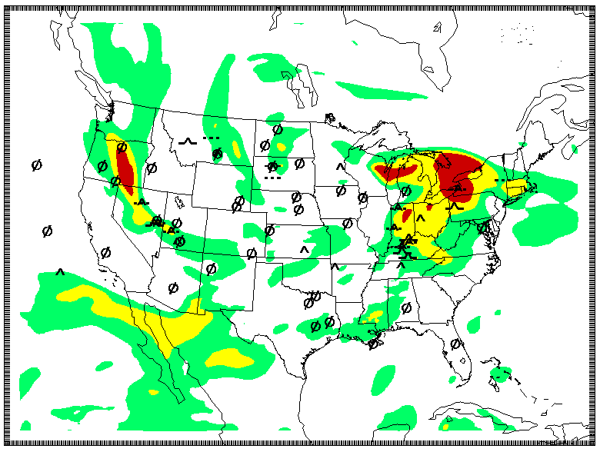
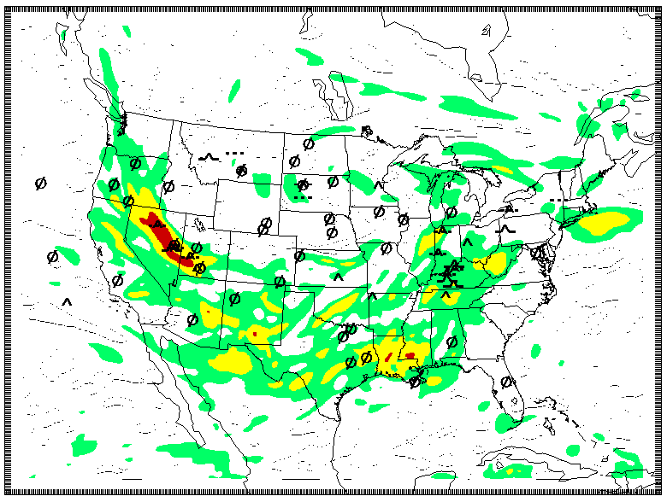
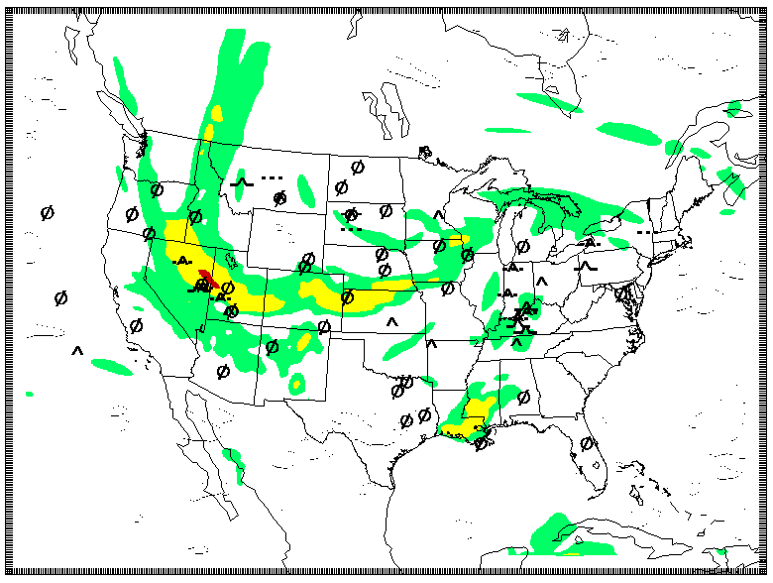
GTG combination
* Probabilistic GTG:
the percentage of CAT and MWT diagnostics exceeding a certain threshold at given grid points.
Ellrod3
Fth/Ri
NGM1
IAWIND
UBF/Ri
DEFSQ
|DIV|/Ri
wsq/Ri
NCSU2/Ri
GTG
EDRLUN
TEMPG/Ri
EDR

Slide 15
Deterministic vs Probabilistic
Deterministic GTG
Ensemble mean of EDR
15 CAT and 15 MWT
Max EDR (CAT, MWT)
The Best Probabilistic GTG
Frequency (%):
The number of CAT and MWT
exceeding 0.14 EDR value /
15 CAT, 15 MWT at given
grid points
Max Prob. (CAT, MWT)
** Definition: A chance of
having 10’s km size eddy
at the given grid box or area

Slide 16
Next Steps for Global Turbulence
Improve data collection and quality control
Improve algorithm tuning and verification
Create global turbulence database
Define and explain probabilistic turbulence forecasts

