Slide 1
HEMS Tool
Project History, Status and Future
James H. Hartman
FAA Aviation Weather Division, ANG-C6
Aviation Weather Research Program
Ceiling and Visibility Program Lead
December 18, 2013 v10

Slide 2
History

Slide 3
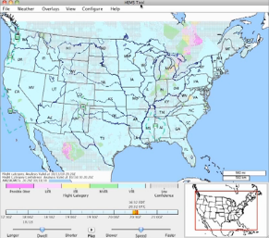
HEMS Tool - History
http://weather.aero/tools/desktopapps/hemstool

Slide 4
HEMS Tool - History
Outcome of the 2006 HEMS Weather Summit
  In order to address Controlled Flight Into Terrain (CFIT) and Loss Of Control (LOC) accidents, the Federal Aviation Administration (FAA) Part 135 Air Carrier Operations Branch (AFS-250), the HEMS industry, and the University Center for Atmospheric Research (UCAR) conducted a HEMS Weather Summit in early 2006.
  The FAA’s Aviation Weather Division, ANG-C6, was not a member of the initial HEMS Weather Summit but the funding for the HEMS tool was absorbed into this office under research activities (AWRP).

Slide 5
HEMS Tool - History
2006 HEMS Weather Summit conclusion:
  Absence of usable C&V data between reporting and forecasting stations. Often, HEMS operators conduct entire HEMS flights in the area between such stations where no reporting exists
  Commitment to provide HEMS operating community access to information which might support better weather decision making in Visual Flight Rules (VFR) operations
    An ongoing R&D program could provide “gridded” ceiling and visibility assessment in areas between METAR/TAF reporting/forecasting sites
    FAA (AFS-250) asked UCAR’s Research Applications Laboratory (RAL) to develop a weather display tool as a part of the Aviation Digital Data Service (ADDS) experimental web portal

Slide 6
HEMS Tool - History
New Helicopter Emergency Medical Service Weather Tool
  FAA Aviation News, Jan/Feb 2007, Volume 46, Number 1
    AFS-250 was, and remains, the Office of Primary Responsibility (OPR) for HEMS
      HEMS POCs
        Roger Sultan, AFS-430
        Andy Pierce, AFS-250
        Richard Prosek, AFS-250
Notes:
The tool could display CVA, METAR, TAF, PIREPS, NEXRAD data, Icing analysis and Forecasts, SIGMETs and AIRMETs, temperature, relative humidity, winds, flight category and a resizable map with hospital locations.

Slide 7
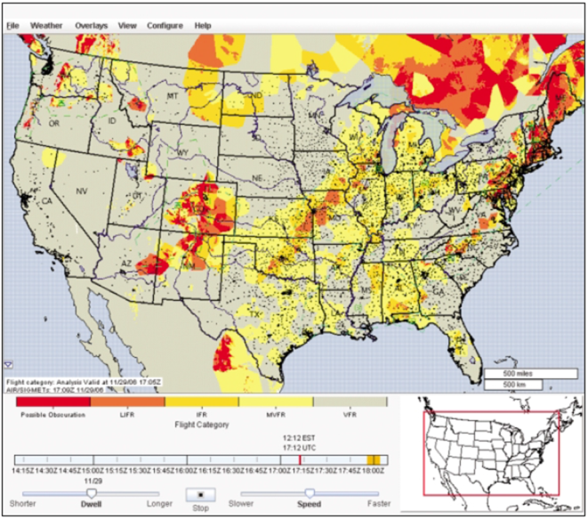
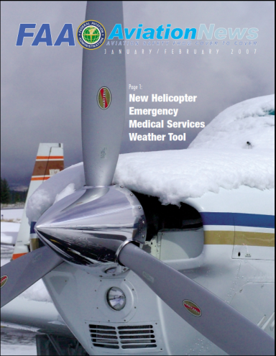
HEMS Tool - History
HEMS Weather Display Tool became available 11/2006 on the ADDS Experimental web portal
www.weather.aero/hems
Notes:
I could find no technical report on the Avmet site. I’m pretty sure that is Jennifer's report and it’s on the internet somewhere but not on the AvMet site which is password protected any way. Ah, here it is.
http://www.esrl.noaa.gov/fiqas/publications/articles/NCVA_D4_SUB_REGION_ENHANCEMENT_FINAL.pdf

Slide 8
HEMS Tool – Specified Use
FAA Notice N 8000.333 was released in conjunction with the use of the HEMS Tool:
  Operators may not use this tool to support IFR operations; only approved use is in VFR operations and then only in the context of supporting a “no-go” decision
  Operators may not use the HEMS Weather Tool as the sole source for decisions to “Go.”
  Operators may only use established primary products, such as METARs, TAFs, area forecasts, weather depiction charts, prognosis charts, etc., to make both “Go” and “No-Go” decisions.
  Since many primary products (such as area forecasts) do not have the specificity to identify highly localized low weather conditions, the HEMS tool can be helpful to resolve assessments at the 5km x 5km grid level.

Slide 9
HEMS Tool – Specified Use
HEMS Certificate Holders may adopt the HEMS Weather Tool into their weather program if approved in their Operations Specifications by the FAA

Slide 10
HEMS Tool Weather Data
HEMS Tool overlays gridded weather on a base map
Model-based grids include:
  Wind speed and direction
  Temperature/Relative Humidity
Algorithmically-derived grids
  Ceiling/visibility/flight category (CVA)
  In-flight icing (CIP/FIP)
Plotted data and NWS products
  METARs, PIREPS
  TAFs, AIRMETs, SIGMETs
  Radar (Base and Composite Reflectivity)

Slide 11
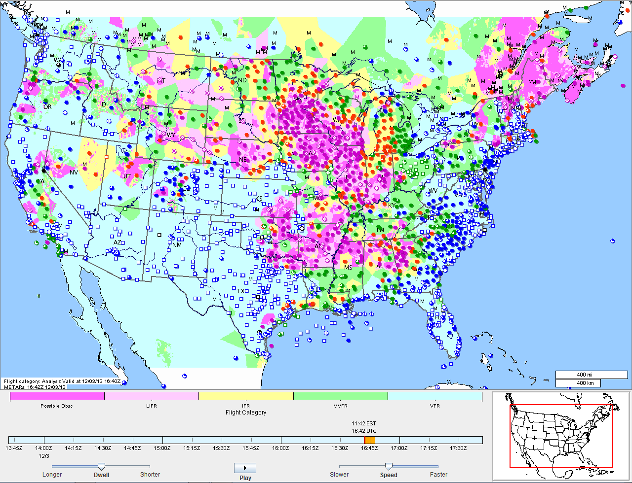
CVA Display in the HEMS Tool

Slide 12
Status

Slide 13
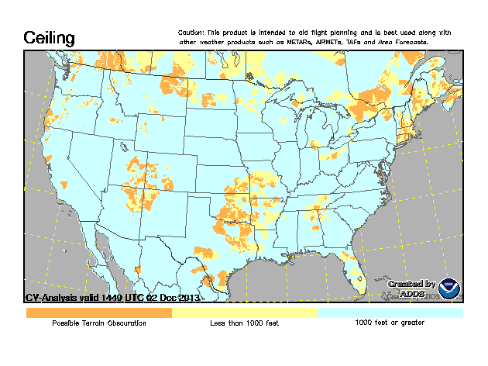
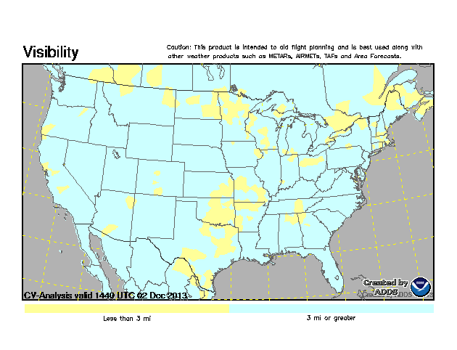
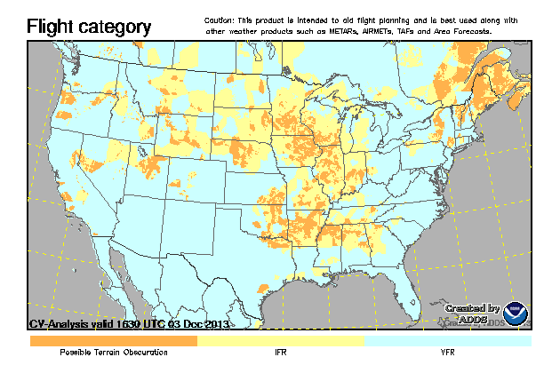
Ceiling and Visibility Analysis (CVA) on Operational ADDS

Slide 14
CVA Performance
Review and Assessment of CVA:
  Technical Review Panel (TRP) Review (November 16, 2009)
  Quality Assessment (QA) Report (November 30, 2010)
    http://www.esrl.noaa.gov/fiqas/publications/articles/NCVA_D4_SUB_REGION_ENHANCEMENT_FINAL.pdf
  Safety Risk Management (SRM) Assessment (August 9, 2011)
Review process concurred with operational release of CVA to NWS in 2012 under the following conditions:
  Flight categories reduced from 5 to 3; IFR, VFR and Possible Terrain Obscuration only
  Precautionary Use Statement with further explanation of CVA weaknesses on the Help Page

Slide 15
Precautionary Use Statement
This product is for flight planning purposes only and should always be used in combination with C&V information from other aviation weather products such as METARs, AIRMETs, TAFs and Area Forecasts. CVA is intended to aid situational awareness with a quick-glance visualization of current C&V conditions across an area or along a route of flight. CVA derives C&V for areas between METAR stations so may, as a function of distance from a METAR, misrepresent actual conditions. See the Help Page for additional information on CVA use and limitations.

Slide 16
HEMS Tool Future Plans

Slide 17
AWRP-sponsored HEMS Tool Enhancements
NCAR to upgrade the HEMS Tool with:
  Improved base maps
  C&V trending
  User addition of specific location designators
  Storage and retrieval of user preferences
  HEMS Demonstration video
Upgrades bundled under Alpha and Beta releases
  Alpha
  Beta
Task #7 – NCAR Evaluation of Alpha Version | 12/31/2013
Task #8 - NCAR updates Alpha based on user feedback | 12/31/2013
Task #10 – NCAR Evaluation of Beta Version | 1/31/2014
Task #11 - NCAR updates Beta based on user feedback | 2/28/2014

Slide 18
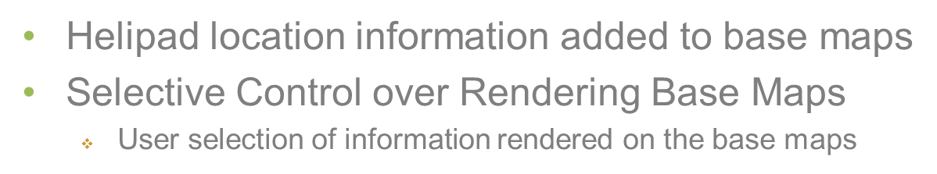
Alpha Upgrades - Maps
Transition to MapServer
  Additional information in base maps
  More selective control of rendering base maps
  Enhanced display capabilities
    Colored elevation, shaded relief terrain, elevation contours
Specific Location Designators
  Users can specify icons for their chosen locations

Slide 19
Alpha Upgrades - Weather
Ceiling and Visibility (C&V) Trending
  Visualize past METAR-based C&V trends
  Visualize TAF-based future ceiling and visibility trends

Slide 20
Beta Upgrades
Storage and Retrieval of User Preferences
  User will have the ability to incorporate storage and retrieval preference functionality
Demonstration Video
  Updated Demonstration Video that incorporates all upgrades completed in this SOW to the Experimental ADDS website
Proposed Strategy for Operational Transition
  Proposed Strategy for Operational Transition of the C&V HEMS Viewer from the Experimental ADDS Website

Slide 21
Questions?

Slide 22
END

