Slide 1
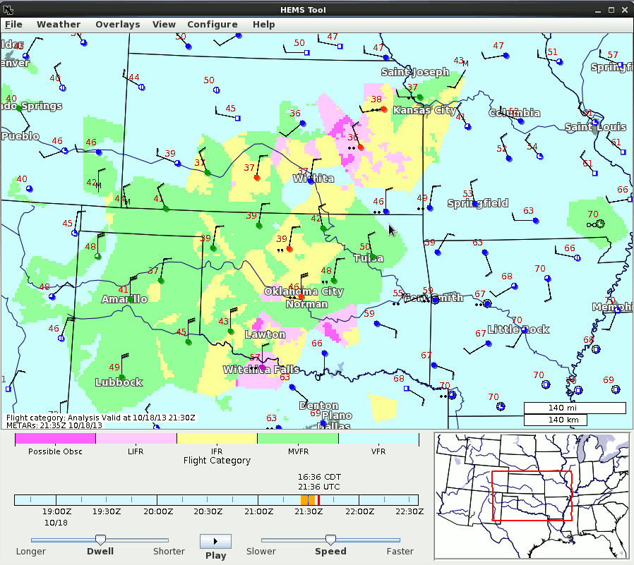
HEMS Tool
Work to Operationalize Ongoing
Awaiting Operational Implementation of MRMS
Next Summer

Slide 2
Reliable and Accessible

